Slide 1
Lake Plan Builder Concept
Lake Links, October 26, 2024

Slide 2
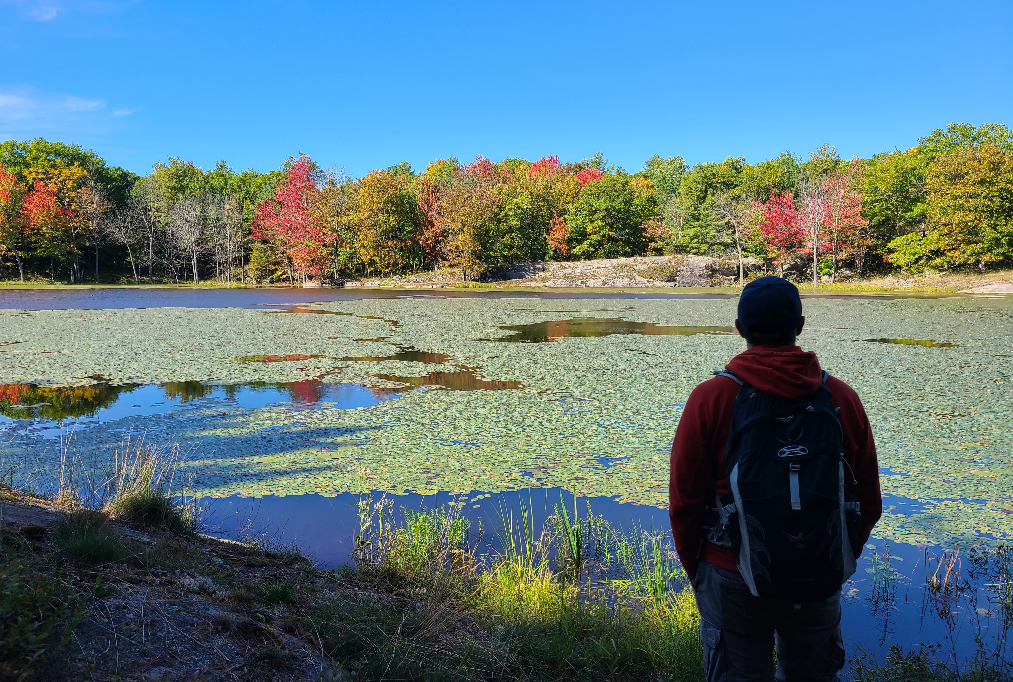
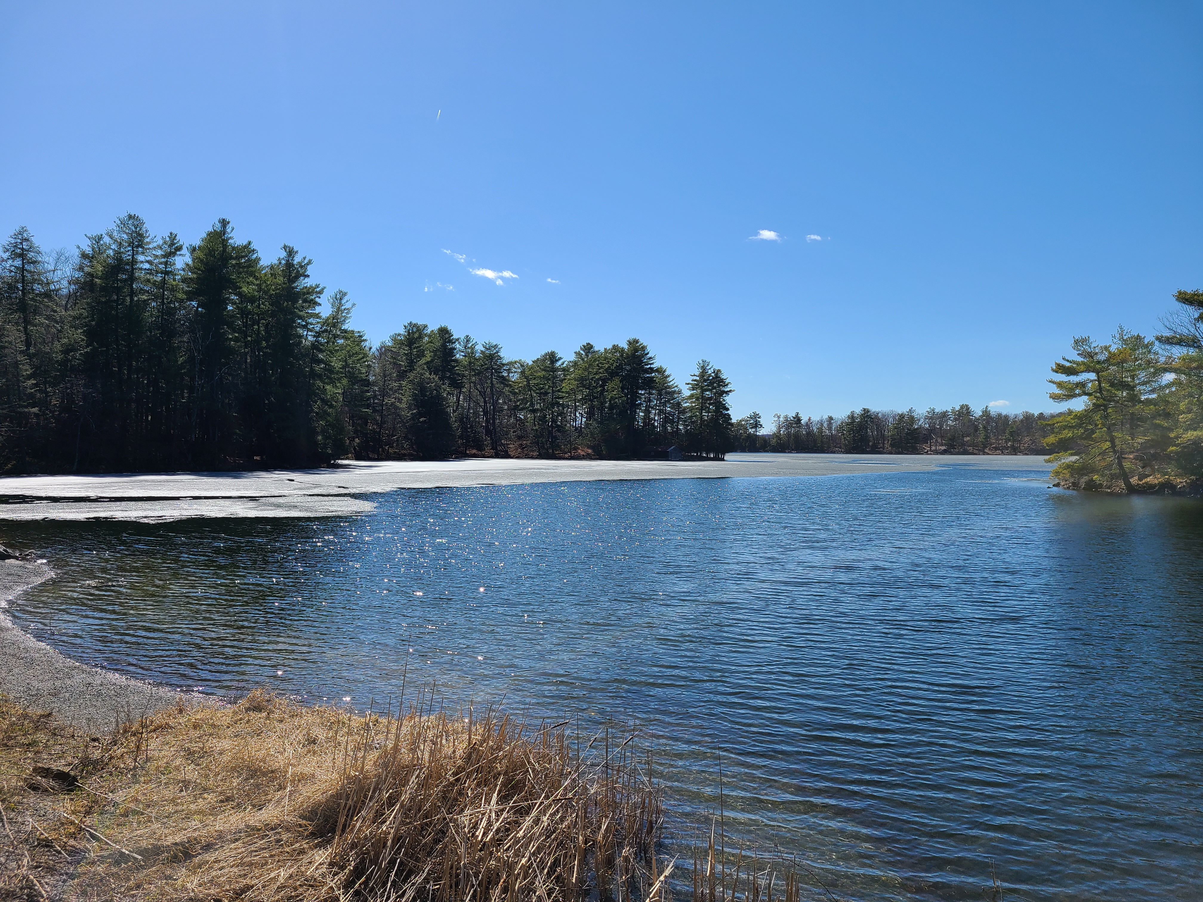
Lake Plans
Identify community-supported, lake-specific actions to protect, enhance and sustainably enjoy the lake.
Usually supported by background information like a State of the Lake Report
Include implementation recommendations for the main organization and others

Slide 3
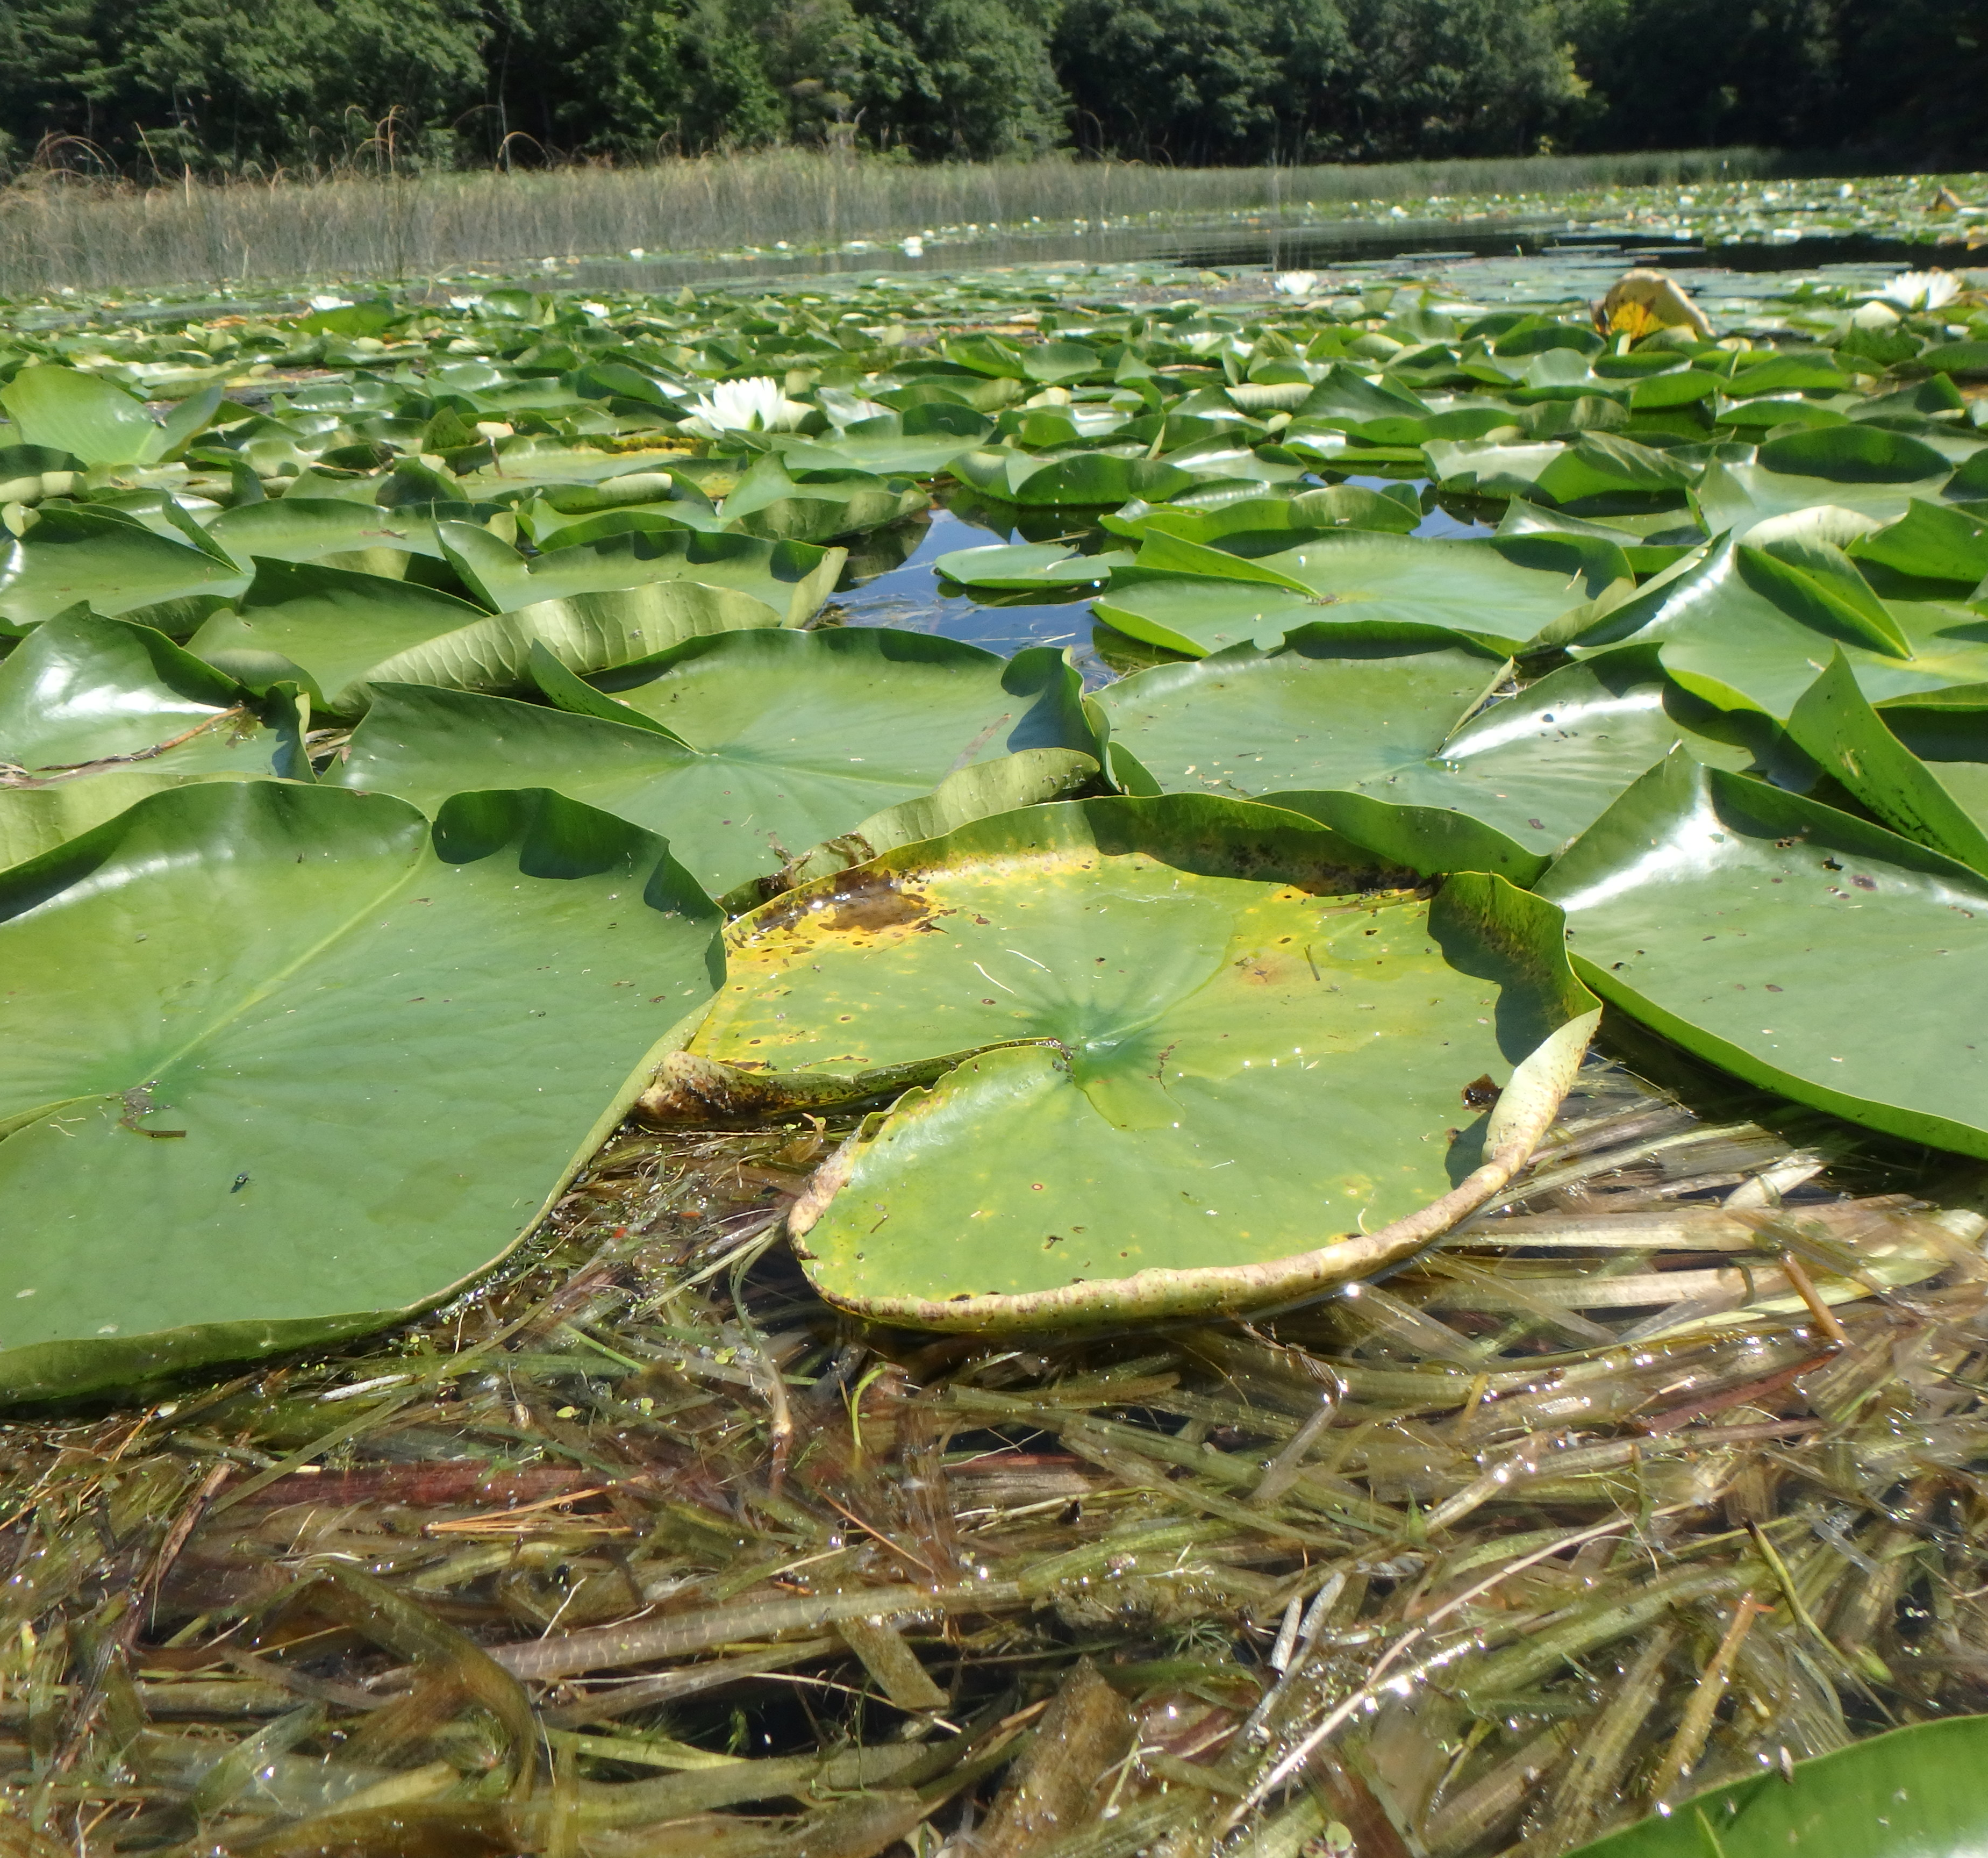
Observations
Common topics of interest and concerns
Similar capacity and extended lake community
Baseline, unified approach would be helpful for implementation partners (municipalities, conservation authorities) and grant applications
Watershed Planning as per the Provincial Planning Statement could draw from from lake plans

Slide 4
Lake Plan Builder – Basic Concept
Goals
Choose from topic-filtered options with lake-specific circumstances and partnerships in mind
Objectives
Pick at least one per goal
Actions
Choose from filtered options to build work, priorities and timelines
Topics
Select to align with membership concerns, interests and values
Publicly available website
Leads user through a series of choices and related guidance to build goals, objectives and actions.
Flags when consultation should be done and offers recommendations.
Includes priority identification and timeline assignments

Slide 5
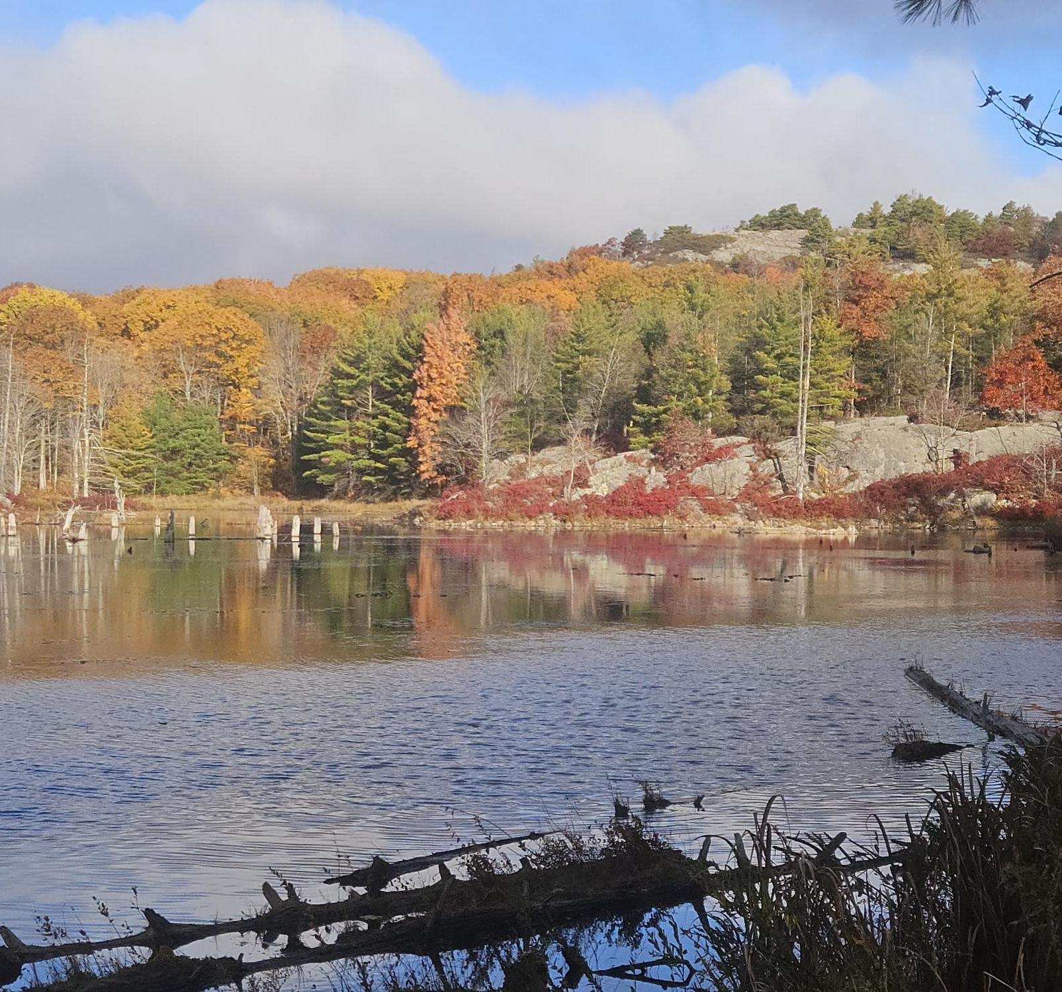
Questions and Next Steps
Good idea?
Would lake associations consider using something like this?
Any comments via email on this topic would be much appreciated
Establish working group
Build work plan
Involve Queen’s Project Course
Seek funding support
Create builder content
Design and create webpage

Slide 6
Holly Evans
Watershed Planning Coordinator
hevans@crca.ca
6`3-546-4228 x233

