Slide 1
OVERVIEW PRESENTATION
ASSOCIATION
PROFILE
Our membership represents Ontario’s 250,000+ waterfront property owners through cottage associations, road associations and individual supporters, whether seasonal or year-round residents of their rural communities.

Slide 2
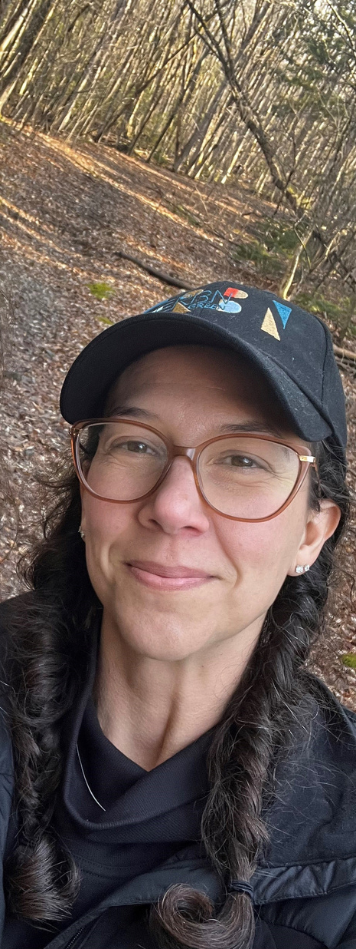
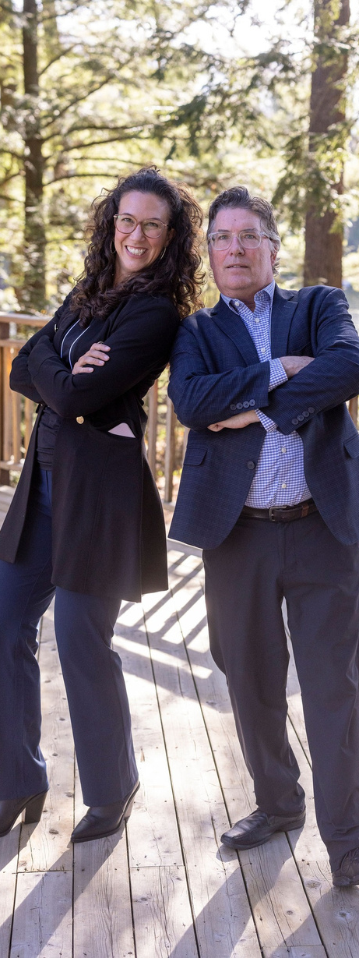
INTRODUCTION FROM OUR CEO
As FOCA’s new CEO, I am honored to step into this role and continue the important work of our association. I want to acknowledge the exceptional leadership of my predecessor, whose dedication and vision have been instrumental in shaping FOCA’s success. Terry’s ongoing support during this transition is deeply appreciated, and I am committed to building on the strong foundation they’ve established.
FOCA is also seeking passionate individuals to join our board of directors. If you’re ready to help shape the future of our association, we encourage you to apply and contribute to our mission.
As we move forward, we remain dedicated to hearing from and representing our members. Your voices are essential to shaping our work, and we look forward to continuing to build a vibrant and engaged community together. Exciting times are ahead!

Slide 3
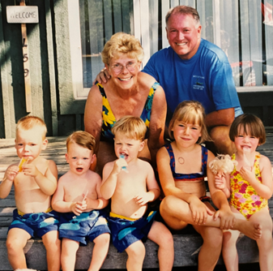
WE ARE THE
FEDERATION OF ONTARIO COTTAGERS’ ASSOCIATIONS
In the face of increasing challenges, our purpose is to empower dedicated stewardship of our lands, lakes and rivers, while protecting Ontario’s cottage culture, heritage and way of life. We do this through advocacy, programs and resources.
Inform. Protect. Unite.
FOCA effectively serves and represents Ontario’s lake associations, waterfront property owners (WPO) and waterfront communities through education, communication and government advocacy.

Slide 4
ABOUT
Who is FOCA?
FOCA represents 50,000 families in more than 525 associations across the province and beyond. We are the province-wide umbrella group for Ontario’s 250,000+ waterfront property owners (WPO), whether seasonal or year-round residents of their rural communities. Since 1963, FOCA has been the voice of the Ontario waterfront. Our united voice carries weight on issues that matter.
‘Cottage country’ matters to Ontario’s economy. Billions are spent each year by waterfront property owners in this province – on watercraft, septic systems, furnishings, taxes, food and drink, cottage maintenance and much more.
FOCA.on.ca

Slide 5
OUR HISTORY
The work continues, and with the support of waterfront property owners and others, FOCA will continue to lead the effort towards a sustainable freshwater future for Ontario.
1963
1974
1985
2024
In January, 125 people representing 40 cottage associations met in a Toronto hotel under the banner of FOCA (the Federation of Ontario Cottagers’ Associations) as a provincial organization.
FOCA is incorporated. The Ontario Minister of Natural Resources, Leo Bernier, wrote “the importance of ‘cottaging’, as a prime recreational need of the citizens of Ontario, is abundantly clear to us at Queen’s Park.” In 1977, FOCA opened an office in Scarborough and hired its first Executive Director. Today the office is located in Peterborough.
FOCA successfully advocated for government action on acid rain and the ban of toxic Dombind as a road-dust suppressant. FOCA also secured municipal voting rights for waterfront property owners and highlighted flaws in Ontario’s property taxation system to the Provincial Auditor and Ombudsman.
FOCA’s Lake Partner Program, the world’s largest freshwater volunteer monitoring effort, marks 30 years. FOCA also developed a Transport Canada-approved boating hazard marker program and created the most comprehensive risk-management program for rural environmental volunteers through the FOCA Association Insurance Program.

Slide 6
LAKE PLANNING HANDBOOK
Making a Lake Plan is a process that requires a devoted group of volunteers to move forward. Although every Lake Plan is unique, there are some commonalities that can help frame your discussions.
FOCA.on.ca/lake-planning
OUT OF PRINT, but members can contact FOCA
for access to the digital edition including a full
resource kit, sample materials, and example lake plans.
FOCA.on.ca/news/publications-videos/

Slide 7
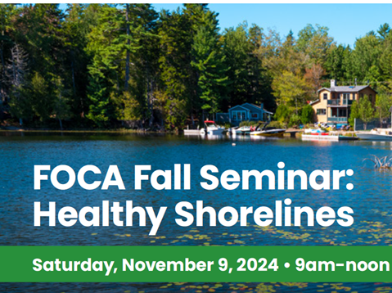
KEY UPDATES
Lake Stewards Magazine
*NEW Individualized Reports
FOCA Fall Seminar, 09 November
Read the 2024 Ontario Lake Stewards Magazine that was published in July, with articles about land use planning, lake management, wildland fire safety, woodstove safety tips, and updates on FOCA’s environmental programs. Download a digital copy at FOCA.on.ca
Lake Partner Program – a joint program of FOCA and the MECP, boasts water sampling data for over 500 lakes across the province. For lakes that have at least 5 years of sampling data on file, new individualized lake reports are now available upon request; email lakepartner@ontario.ca
Register now for the FOCA Fall Seminar, being held by webinar only. Theme “Healthy Waterfronts” with talks on septic system re-inspections, source water protection, identifying aquatic plants, algae, water sampling and more.
See the agenda and register online here: https://foca.on.ca/events/#upcoming

Slide 8
STRATEGIC PLANNING 2025-2027
NOV
AGM
Board and staff have been deeply involved in the gathering input from key stakeholders, analyzing past performance data, identifying priorities, and drafting preliminary goals to serve as a foundation for deeper discussions and refinement during 2-days in November with our strategic facilitator.
At the AGM, the 3-year strategic plan will be presented in a clear, structured format, highlighting key updates, achievements, financials, and future goals to engage members and facilitate informed decision-making. We look forward to seeing you all on March 1, 2025.

Slide 9
CONTACT US
FOCA has hundreds of pages of rural waterfront resources! Search any topic on our website. FOCA is a not-for-profit, member-driven organization. We are here year-round to serve our members!
705-749-3622
www.FOCA.on.ca
info@foca.on.ca
#201 – 159 King Street
Peterborough, Ontario K9J 2R8

