Slide 1
Climate Change Implications for our Lakes
23rd Annual Lank Links Workshop
Elgin, Ontario
October 26, 2024
Paul Lehman
Notes:
Good morning and thank you to the organizers for todays workshop. I have been asked to speak about how our changing climate might influence our lakes and how can we address this through planning. I will be drawing on work completed on the Mississippi River to help us understand how climate change would affect the watershed and provide guidance on how to adapt to these changes.

Slide 2
IPCC Sixth Assessment Report (2023)
Human activities, principally through emissions of greenhouse gases, have unequivocally caused global warming, with global surface temperature reaching 1.1°C above 1850-1900 in 2011-2020.
The Paris Agreement (2016) ratified a Long-term Temperature Goal of limiting global temperature increase to well below 2°C, while pursuing efforts to limit the increase to 1.5 °C.
Modelled pathways consistent with the continuation of policies implemented by the end of 2020 lead to global warming of 3.2 [2.2 to 3.5]°C (5–95% range) by 2100 (medium confidence)
Notes:
The UN IPCC has been studying and reporting on the impacts of climate change for over 35 years and in March 2023 it’s sixth assessment report was released. The report concludes that in the period 2011-2020, average global surface temperatures reached 1.1°C above the pre-industrialized period defined as 1850-1900.
In 2016, the Paris Agreement ratified a long-term temperature goal of limiting increases to below 2°C and pursuing efforts to limit the increase to 1.5°C.
Climate models and their predictions continue to evolve and have used concentration pathways to address uncertainty in future emission scenarios. The latest assessment report concludes that if we continue with the climate policies implemented as of 2020, temperature increases will reach 3.2°C by 2100 or roughly three times what they are today.
So given these global projections, how can we put this into a local context to help us better understand the implications?

Slide 3
1900 – 1950 mean (5.4 °C)
Notes:
The Ottawa CDA climate station has records dating back to 1900 and by plotting the mean annual temperature over this period of time we can see the mean annual temperature in the period 2011-2020 is approximately 1.9°C higher than the 1900-1950 time frame. The WMO also reported that 2023 was the warmest year on record which is consistent with the observations in Ottawa.

Slide 4
Notes:
When we plot the annual precipitation recorded we can notice a slight increase in precipitation over the period of record.

Slide 5
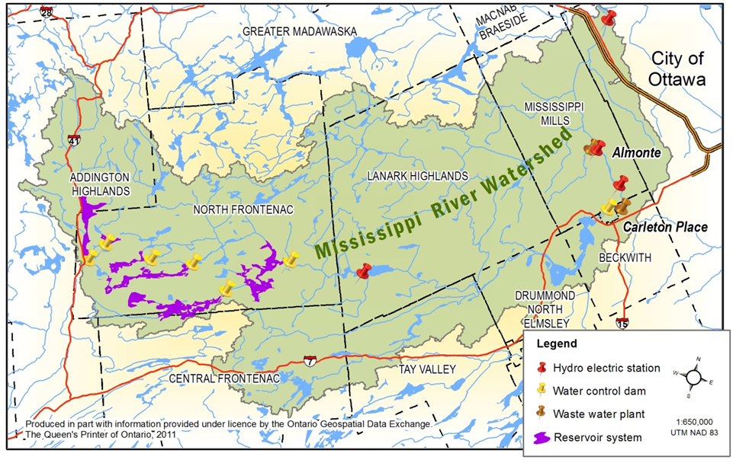
WSC 02KF006
Notes:
So while we see changes occurring within our local climate, as water resource managers it raised questions as to how this might affect our river systems and how we might have to adapt. The Mississippi River watershed, located west of Ottawa, supports a complex network of rivers, streams and lakes over an area 3,800 km2. We are fortunate that on the Mississippi River the Water Survey of Canada operates a stream gauge located just downstream of Carleton Place with streamflow records dating back to 1919. By inspecting these records we can gain some insight into how stream flows have changed over the past 124 years.

Slide 6
Notes:
By plotting the average annual streamflow over time we can notice a slight increase in total streamflow volume over time which again is consistent with precipitation records from Ottawa.

Slide 7
Notes:
When we consider the average stream flow in the winter (Jan & Feb) we can notice a trend towards higher stream flows particularly in the last half of the record. We saw that the temperature increase in Ottawa in this later period was 1.9°C, however the greatest temperature increase occurs in the winter by as much as 3.6°C.

Slide 8
Notes:
The average summer (Jul – Oct 15) stream flows indicate a greater range in stream flow conditions again during the later part of the record.

Slide 9
Notes:
And if we look at the minimum summer stream flows, expressed as a 7-day average there is again more variability from year to year, however it can be noticed that the occurrence of stream flows falling below 5 cms increases in frequency which was of concern on the Mississippi River as it is a regulated system with an objective of maintaining a stream flow of 5 cms at this location.

Slide 10
Observed Trends
Marginal increase in annual stream flow volume
Substantial increases in winter stream flow
Marginal increase in summer stream flow coupled with significant high stream flow events
Trend towards lower and more frequent low flow events in the summer
Higher variability in stream flow conditions
Notes:
The observed trends in the stream flow record are consistent with the IPCC’s 5th Assessment Report for North America and appear to be attributable to underlying changes in our local climate. In order to properly understand how projected changes in climate might affect the river system, we needed to account for the various aspects of the watershed’s hydrologic system.

Slide 11
Methodology
Climate Analysis
Multiple GCM’s and Emission Scenarios
Drummond Centre climate station
Daily precipitation and temperature values
4 – 30 year periods
  Base Case 1970 – 2000
  Future 2011- 2040
  Future 2041 – 2070
  Future 2072 – 2100
Hydrologic and Reservoir Model Simulation
Notes:
To accomplish this the output from multiple Global Circulation Models under three Emission Scenarios were downloaded for the Drummond Centre climate station located in the Mississippi River watershed. This output was used to generate daily precipitation and temperature values over 4, 30 year periods. The Base Case represents the GCM’s simulation of the historic period while the future periods represent future projections. These daily precipitation and temperature values are then used as input to a hydrologic model and simulate runoff from the watershed and reservoir system to obtain daily streamflow values at the point of interest.

Slide 12
Notes:
This graph represents the average stream flow rates at the Appleton stream gauge for the Base Case period over the course of the year. It demonstrates a typical response for streams in eastern Ontario with relatively low, stable flows over the winter period followed by a significant increase in the March – May time frame as the melting snowpack and rainfall in the spring contributes to runoff. Runoff subsequently recedes leading to relatively low stream flow rates over the summer.

Slide 13
Notes:
As stream flow conditions are projected into the future, we can expect significant increases in winter stream flows with earlier freshets occurring, followed by lower stream flows over the summer, which is consistent with our observations of the historical stream flow record.

Slide 14
Stream Flow implications
High Flow Events
Period | Mean Annual Maximum Flow (m³/s ) | 20th Percentile (m³/s ) | 80th Percentile (m³/s )
Base Case | 108.76 | 72.84 | 137.87
2011 - 2040 | 126.28 | 125.87 | 119.59
2041 - 2070 | 116.36 | 71.02 | 153.44
2071 - 2100 | 130.85 | 79.31 | 182.96
20%
33%
Notes:
When we consider the daily peak flows generated from the analysis, we can expect maximum annual flows to increase by 20% – 33% by 2100.

Slide 15
5 cms stream flow objective
Notes:
As for minimum flows in the summer, low flow conditions are expected to occur more frequently and extend for longer periods of time.

Slide 16
Fish, Fisheries and Water Resources: Adapting to Ontario’s Changing Climate (2011)
Lead by Dr. J. Casselman (Queen’s University)
Based on research in the Bay of Quinte and several decades of fish sampling studies, investigated the correlation between climate warming and fish recruitment in the Mississippi River watershed.
Notes:
Changing topics, Dr. John Casselman from Queen’s University lead an investigation into the effect of climate change on fish communities in the Mississippi River. While this project involved various sub-components I would just like to touch on his findings of most relevance to todays purpose.

Slide 17
Notes:
Casselman developed a fish recruitment – temperature relationship which demonstrated that over a 30 year period, there was a significant decline in cold-water fish species of approximately 60% while warm-water species recruitment over a 20 year period increased by 60%. This corresponded to an increase in summer surface water temperature of 1°C. Casselman concluded that a relatively small increase in temperature is associated with a substantial increase in recruitment of warm-water species and a reduction in recruitment of cold-water species.

Slide 18
Source: Dr J. Casselman
Notes:
Based on future climate projections, he estimated that surface water temperatures would increase 4°C by 2100. This would subsequently result in a 23 fold increase in year class strength for these warm-water species. This provides additional confirmation that fish community structure and dynamics are changing in association with climate warming.

Slide 19
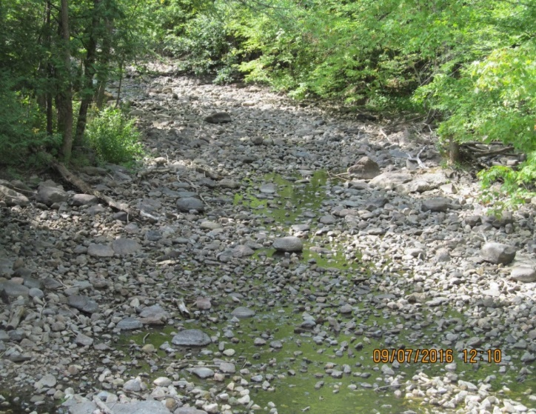
Summary
Climate
  air temperature projected to increase 4°C (summer 3.2°C, winter 5.3 °C)
  precipitation projected to increase 9% (summer -3.3%, winter 17.9%)
Stream flow / water levels
  earlier freshet
  more variable and erratic flows
  increased flood risk (20% - 33% dependent on location)
  more frequent and prolonged low flow conditions
Longer ice-free periods
  Uncertain lake ice quality
Higher surface water temperatures
  shift from cold-water to warm-water species
  lower dissolved oxygen levels
  algae growth
Notes:
To recap, our annual air temperature is projected to increase 4°C with average summer temperatures rising 3.2°C and average winter temperatures rising by 5.3 °C. Annual precipitation will increase by 9% wit the bulk of that increase 18% occurring in the winter.
Stream flow and by extension lake water levels will experience more variability where the typical snowmelt freshet will occur some 5-6 weeks earlier. We expect to see a potential for increased flood risk although this will be highly dependent on the type of river system. We can expect to see more frequent and prolonged low flow periods where stream segments can become isolated. Regulated systems such as the Mississippi River may be able to mitigate these impacts to some extent but there a limits which can be exceeded.
Longer ice-free periods may have a range of implications for our lakes including ice safety during the winter months.
Higher surface water temperatures will result in changes in fish communities, degraded water quality and algae growth.

Slide 20
Adaptation
Retain functionality and diversity of natural systems
Wetland retention
  serve as a buffer to severe hydrologic events
  reduce nutrient loading to surface waters
  carbon sequestration
Encourage shoreline buffers
  direct runoff away from shorelines
  minimize nutrient loading
  Encourage healthy shorelines
Continue to anticipate and adapt to changes in water levels
Continued monitoring, planning and adaptation
Notes:
Our lakes are dependent on the natural systems which support them such as stream corridors, wetlands, shorelines and forest. By maintaining and enhancing the health of these natural systems we can improve their resiliency to the projected impacts of a changing climate.

Slide 21
Thank you

