Slide 1
Mississippi Lakes Association
Benefits of the
Lake Planning Process
what we learned (and continue to learn)
on Mississippi Lake
Rob Bell, President
André Langlois, Secretary
MLA-AGM-2023
LAKE LINKS Workshop, 26 Oct 2024

Slide 2
Outline
Purpose of a Lake Plan
Particular Circumstances
The MLA journey
Benefits
Lessons learned
MLA-AGM-2023
LAKE LINKS Workshop, 26 Oct 2024

Slide 3
Purpose
Build a stronger Lake community to promote discussion and, most importantly, take action
Focus activities and scarce resources (human, financial)
Identify and protect lake values
Set environmental & social objectives
Educate and communicate
Establish credibility and respect as an Association
MLA-AGM-2023
LAKE LINKS Workshop, 26 Oct 2024

Slide 4
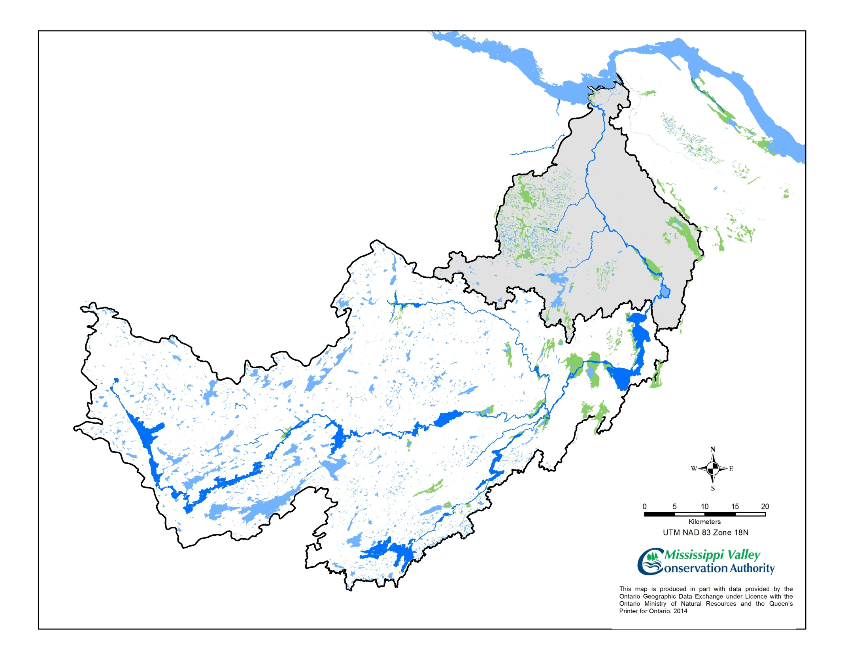
MLA – Particular Interest
Mississippi Lake is near the bottom of the watershed.
90% of the water volume comes through the main channel at Innisville ( )
Mississippi River System
Lower
Watershed
Clyde River
system
Upper
Watershed
0
Mississippi
Lake
Mississippi River and Buckshot Creek system
Fall River and
Bolton Creek
system
MLA-AGM-2023
LAKE LINKS Workshop, 26 Oct 2024

Slide 5
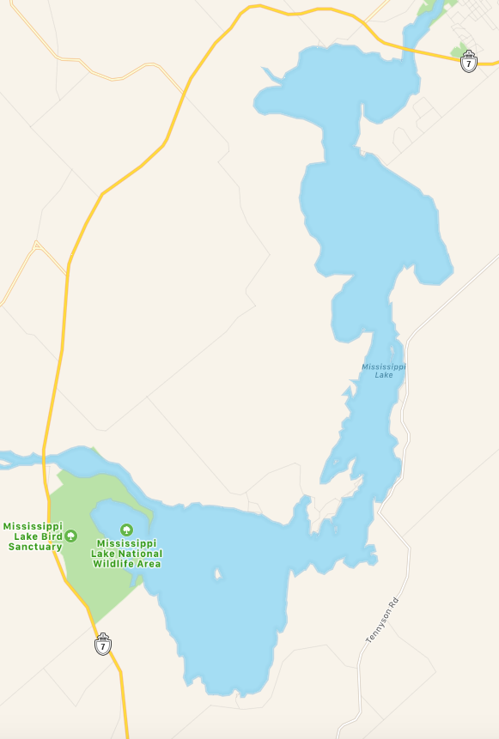
MISSISSIPPI LAKE
ROAD ASSOCIATIONS
2
1
3
We thank all our partner road associations, whose members belong to and support the MLA. We welcome other road associations to join with us as well. For information and support, contact our Roads Committee Chair, Chris Winter, at: roads@mlakes.org
MLA supporters in GREEN
4
35
Mississippi Mills
34
1 McDiarmid’s Shore
2 Knowlton Place Road Association
3 Montgomery Park
4 Dowdall Shore Homeowners Association
5 Rathwell Shore Community Association
6 McCann’s Shore
7 Twin Oaks Association (Ab's Road)
8 Ikwe Point Road Association (Sinclair Shore)
9 Willis Island Road Association (Sinclair Shore)
10 Otterslide Lane (Sinclair Shore)
11 Pretties Island Property Owners Association
12 Ebbs Bay Property Owners Association
13 Cooke’s Shore Association
14 Rothwell Park Road Association
15 Innisville South
16 Grasshopper Point Road Association
17 Islandview Association
18 McCreary’s Shore
19 McCullough’s Landing
20 Flintoff Bay
21 Mallochs Bay
22 Robertson’s Shore
23 Beck’s Shore (McNaughton Shore)
24 Red Rock Bay
25 Black Bass & Hunters Bay Property Owners Association
26 Craig Shore Road Association
27 Father Point
28 Coleman’s Shore (Moonlight Bay Rd. and Sunset Ln.)
29 Munro Lane (High Bank)
30 Longview Island
31 Petrie Shore
32 Gardiner Shore Association (10th Line Shore)
33 Lakeside Drive Homeowners Association (Hay’s Shore)
34 Lake Park Hunting and Fishing Club
35 Lake Park Community Association
5
33
6
32
Beckwith
7
31
Drummond /
North Elmsley
8
30
9
10
29
14
13
11
28
12
John’s
Marina
15
27
26
16
24
25
17
23
18
22
19
20
updated: 20 Jul 2023
21

Slide 6
The Journey
4-year time frame 2011-2015
Lake Community Survey May 2012 – Dec 2013
325 responses
Presentations at AGMs starting in 2011
Articles in the Mississippi Belle magazine
Lake Planning Committee formed Jul 2012
Lake residents, MVCA, Watersheds Canada, Municipal Councillors
monthly meetings
Professional Consultant: French Planning Services
Presentations to Municipal Councils 2014
Two Public Consultations 2014
MLA-AGM-2023
LAKE LINKS Workshop, 26 Oct 2024

Slide 7
The Journey – continued
Mississippi Lake Today Report 2014, 2015
Lake Plan approved at the AGM 30 May 2015
MLA Committees formed June 2015
Communications
Environment
Boating and Recreation
Lake Plan Implementation Group formed 2015
converted Actions Table to Progress Charts
Presentations to four Municipal Councils 2015/2016
Improved our communications capacity
revamped the website
started a Facebook account
adopted MailChimp; created an e-Newsletter
MLA-AGM-2023
LAKE LINKS Workshop, 26 Oct 2024

Slide 8
Major Contributors
MVCA
Alyson Symon
initial impetus, meeting venue, publications
Watersheds Canada
financial assistance via grants (Trillium, RBC, TD, Valley Heartland)
French Planning Services
Randy French, Gord Rogers
Municipalities
Carleton Place, Mississippi Mills, Beckwith, and Drummond & North Elmsley all participated in the Lake Plan Committee and the Technical Advisory Committee
MLA-AGM-2023
LAKE LINKS Workshop, 26 Oct 2024

Slide 9
Resultant Lake Plan - 2015
6 Goals, 18 Objectives, 66 Actions
Water Quality 4 Objectives 16 Actions
Aquatic Vegetation / Algae 3 Objectives 8 Actions
Water Levels / Flooding 2 Objectives 5 Actions
Natural Environment 5 Objectives 19 Actions
Land Use and Development 2 Objectives 8 Actions
Social and Recreational Activity 2 Objectives 10 Actions
The Plan was updated in 2021. A further update is planned for 2026 to ensure continued relevance and feasibility
MLA-AGM-2023
LAKE LINKS Workshop, 26 Oct 2024

Slide 10
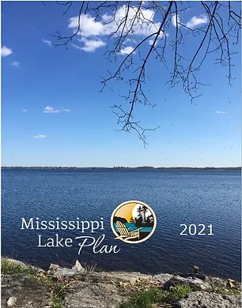
The Plan
2015
2021
MLA-AGM-2023
LAKE LINKS Workshop, 26 Oct 2024

Slide 11
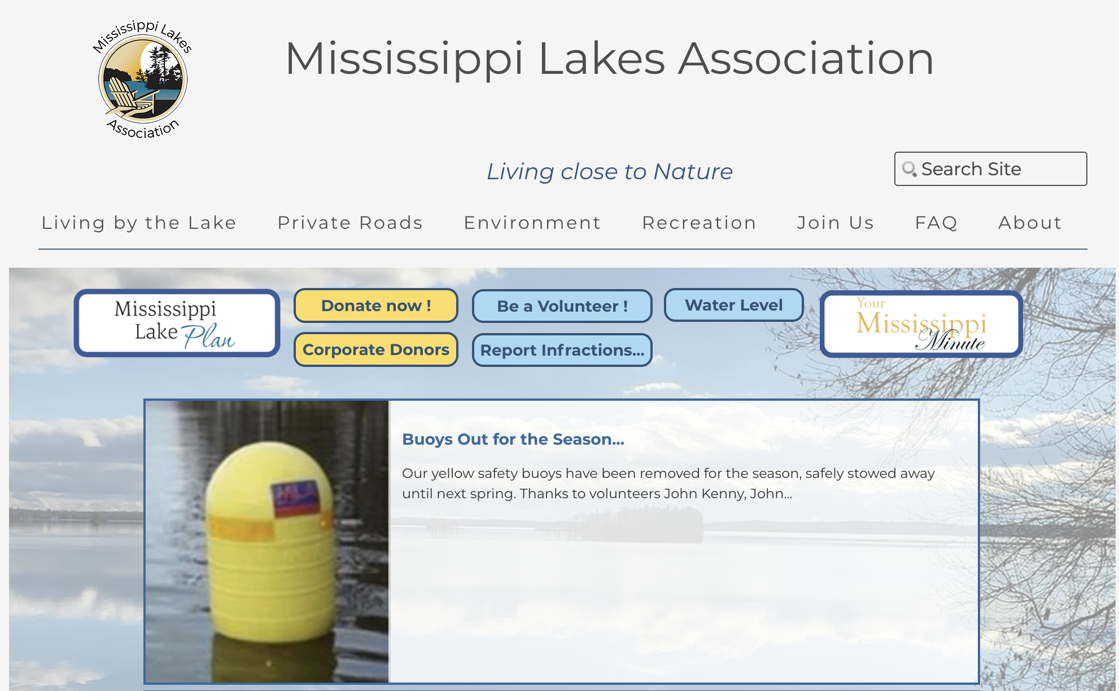
the Plan on our website
MLA-AGM-2023
LAKE LINKS Workshop, 26 Oct 2024

Slide 12
Benefits
Create and/or strengthen the social network:
increase Membership in the Association
attract Volunteers
build cooperation from the Lake Community
Align efforts with partners:
MVCA, Watersheds Canada
Other NFP Associations (FOCA, MVFN)
Municipal Councils
Use valuable resources more effectively and efficiently:
volunteers, funding
Gain credibility and recognition:
when advocating on behalf of the lake community
when seeking membership and financial support
MLA-AGM-2023
LAKE LINKS Workshop, 26 Oct 2024

Slide 13
Lessons Learned
manage Perception
develop realistic Goals
recruit Champions / Volunteers
seek Professional Assistance (MVCA, Consultant)
seek Funding from several sources
allow plenty of Time / exercise plenty of Patience
maintain Momentum / Perseverance
Consult, Consult, Consult
Communicate, Communicate, Communicate
the Plan is a tool, not an end state
MLA-AGM-2023
LAKE LINKS Workshop, 26 Oct 2024

Slide 14
In summary
Developing our Lake Plan was...
quite a bit of work, but the results have been invaluable in progressing the MLA’s activities in a coherent, effective, and affordable manner. Therefore, the benefits of developing a Plan were
... well worth the effort!
MLA-AGM-2023
LAKE LINKS Workshop, 26 Oct 2024

Slide 15
?
Questions?
Rob Bell, President president@mlakes.org
André Langlois, Secretary secretary@mlakes.org
General Inquiries: info@mlakes.org
Website: https://www.mlakes.org
MLA-AGM-2023
LAKE LINKS Workshop, 26 Oct 2024

