Slide 1
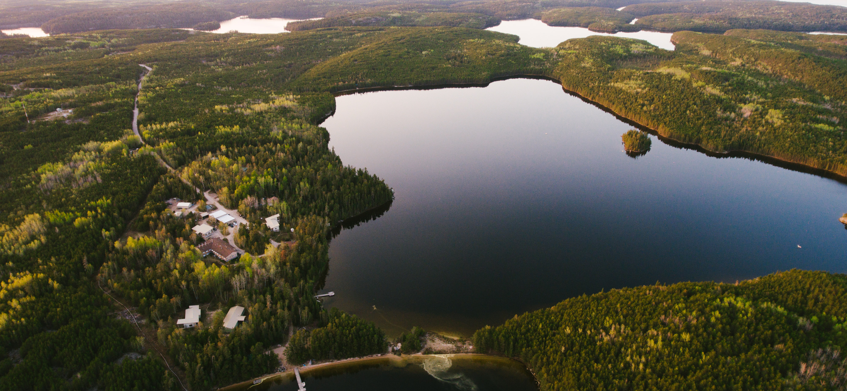
Keeping up with our changing lakes: 50+ years of data from the IISD Experimental Lakes Area
Presented by Thomas Saleh for Lake Links
October 26, 2024

Slide 2
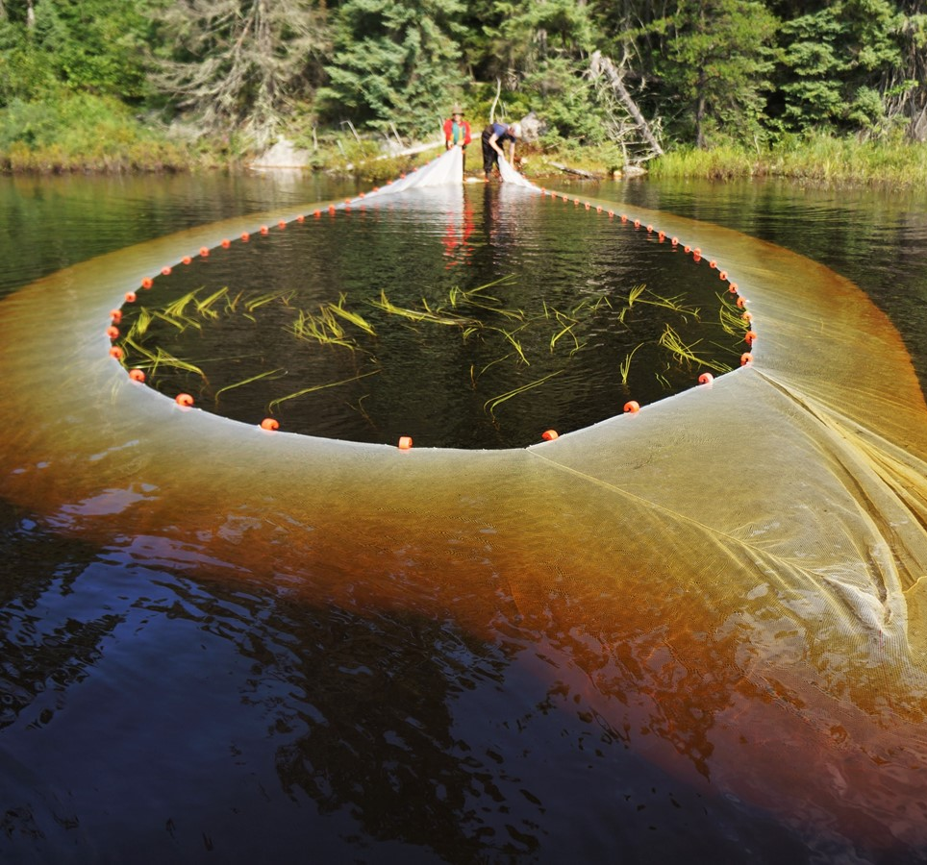
Outline
Planning for Climate Change at ELA
What have we learned in over 50 years of research?
Trends in our long-term data
Big data – machine learning and forecasting for limnology

Slide 3
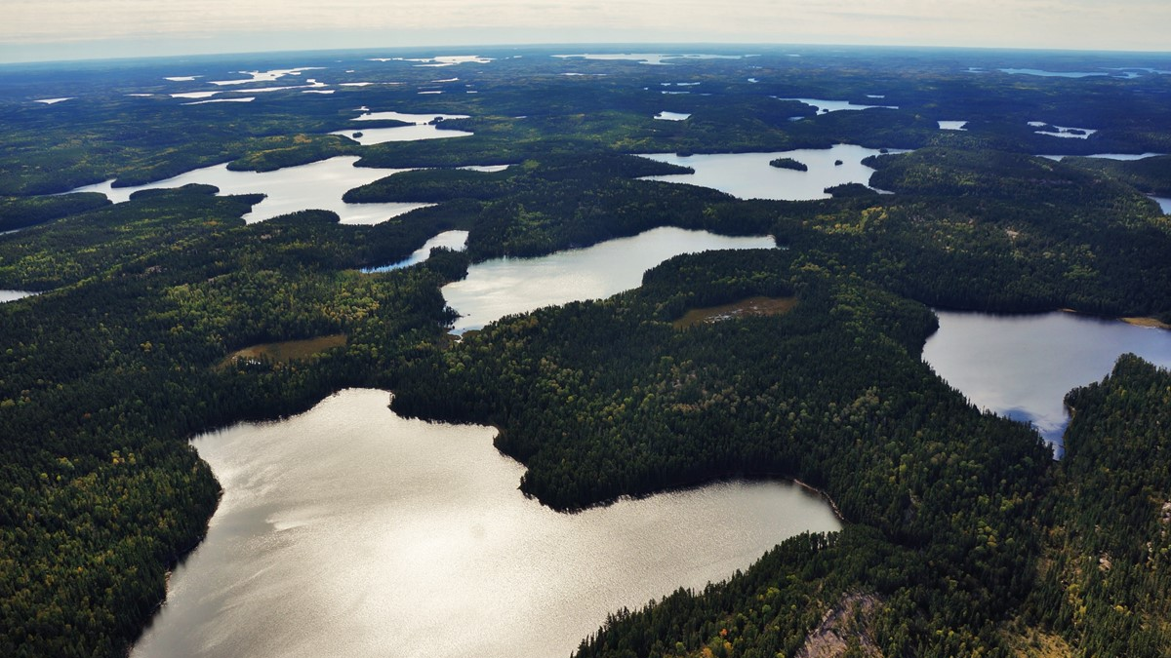
This is our lab.

Slide 4
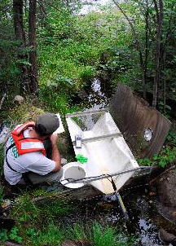
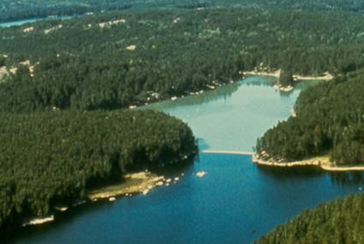
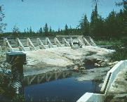
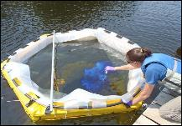
IISD Experimental Lakes Area
Ecosystem Experiments
>50 whole ecosystem manipulations
  Physical (e.g. artificial reservoirs, water diversion)
  Chemical (e.g. nutrients, acid, hormones, metals)
  Biota (e.g. aquaculture, trophic cascade)
Sub-ecosystem experiments

Slide 5
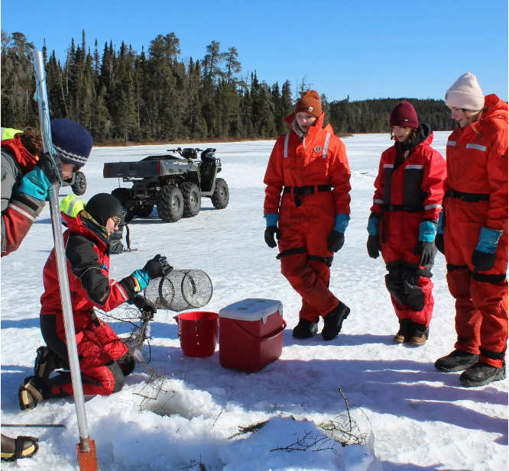
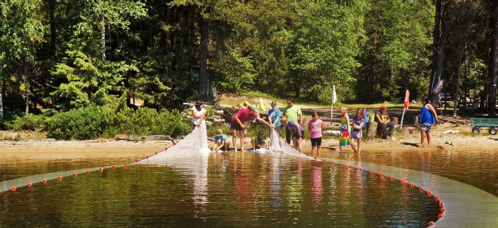
IISD Experimental Lakes Area
Outreach and Education
Field courses (high school, university)
Scholarships and Fellowships
Public tours
Newsletter

Slide 6
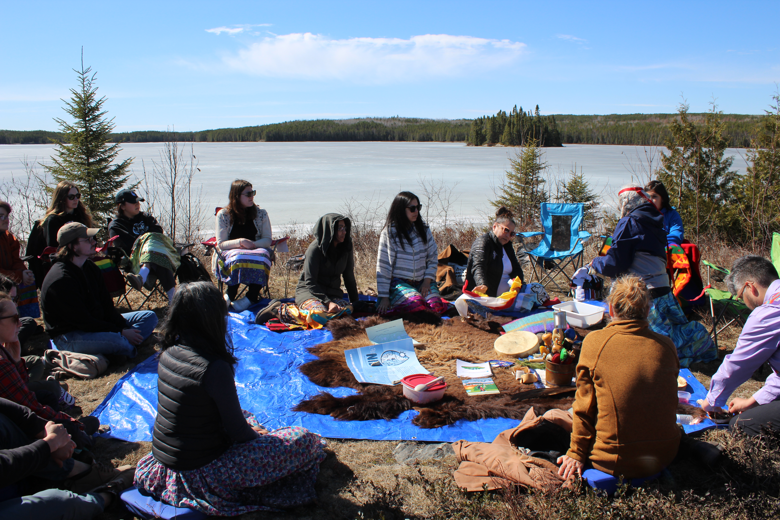
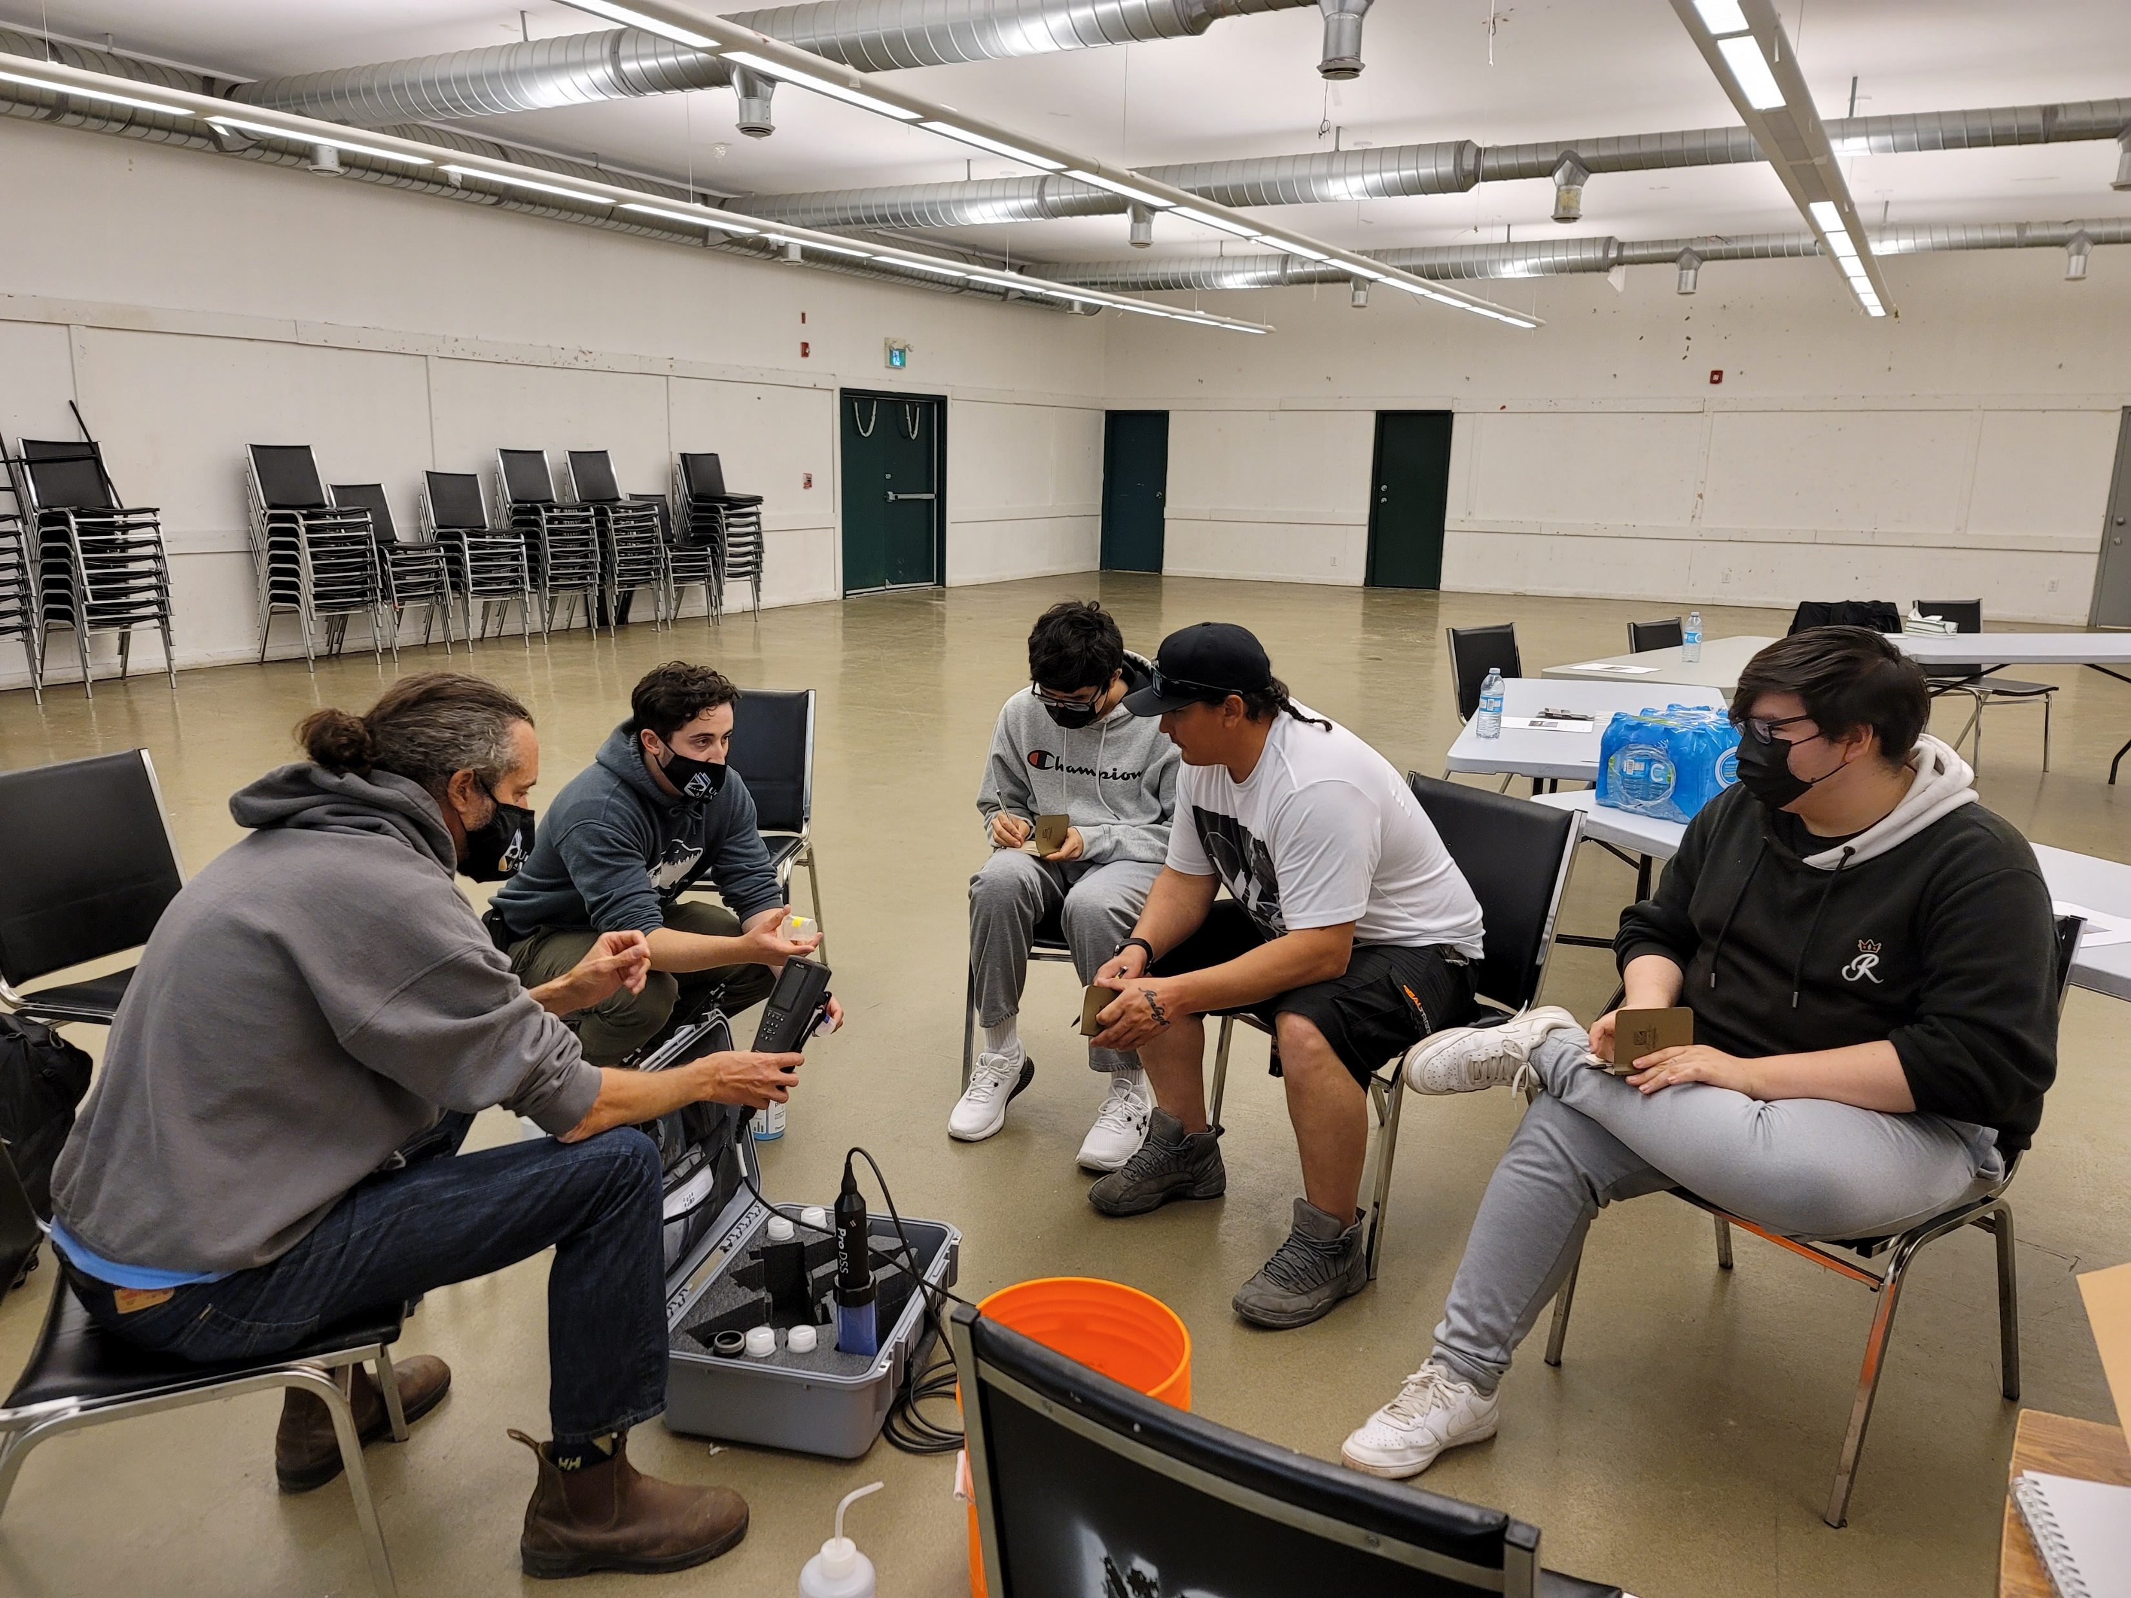
IISD Experimental Lakes Area
Indigenizing Our Science
Caring for the land
Working across generations
Planning 7 generations ahead

Slide 7
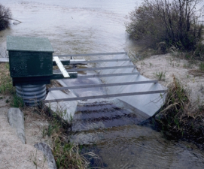
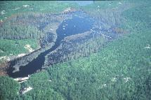
IISD Experimental Lakes Area
Long-term Ecological Research (LTER)
5 LTER lakes
Meteorology
Hydrology
Water quality
Food web
  Phytoplankton
  Zooplankton
  Fish

Slide 8

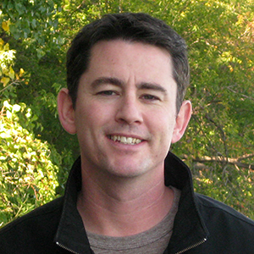
Some Acknowledgments
Michael Paterson has worked as a Research Scientist at the Experimental Lakes Area (ELA) since 1992. His research has focused on the ecosystem effects of human activities on freshwater lakes and his areas of expertise include aquatic food webs, plankton ecology, nutrients, and contaminants
Scott Higgins is a research scientist for the Experimental Lakes Area, focusing on algal ecology, primary production, climate change and the effects of invasive species on freshwater ecosystems.

Slide 9
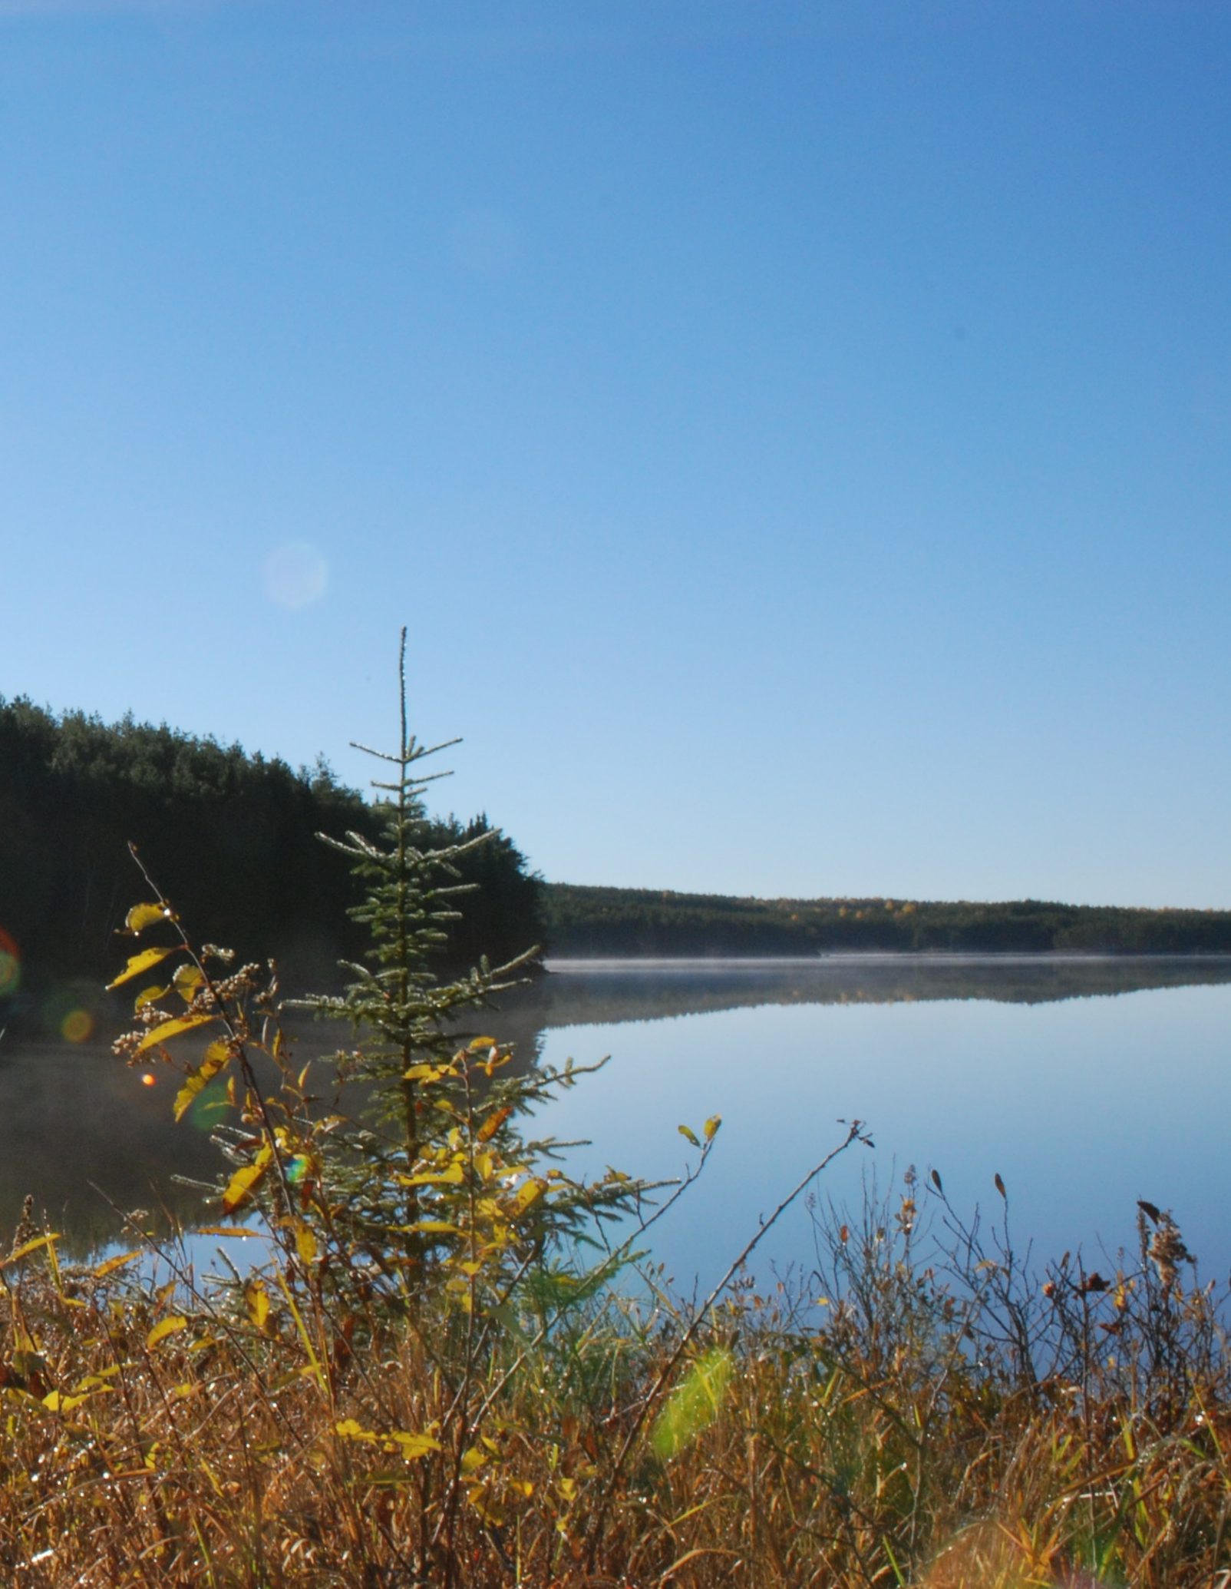
Trends in our long term data
5 key findings from our LTER data
Our air is getting warmer
Our lakes are getting less icy
Our lakes are getting darker and… cooler?
Our fish are squeezing into smaller habitats
Our fish are getting smaller

Slide 10
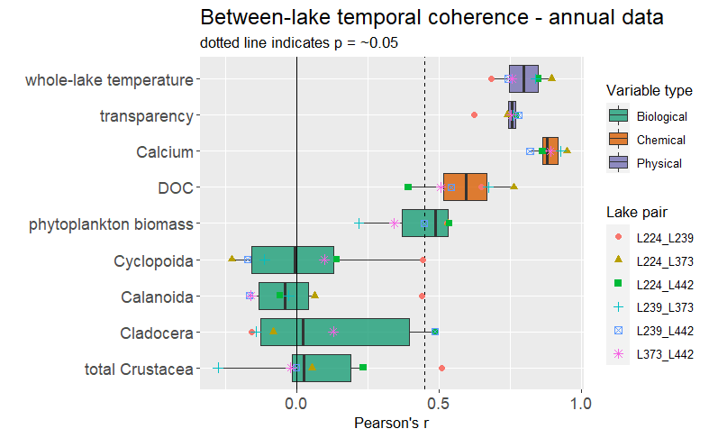
Notes:
As part of my analyses, I examined the temporal coherence between all lake pairs for different variables. In general, one would expect high coherence for variables affected primarily by regional factors – ie all lakes would react similarly. In contrast, if a variable is primarily affected by within-lake factors, one might expect low temporal coherence. This a box-plot of Pearson’s r between all lake pairs for biotic variables in green, chemical variables in brown, and physical variables in purple. You can see that changes among years for physical variables, temperature and Kd, are highly correlated. The dotted line denotes the approximate line of statistical significance (it varies a little depending on the number of lake-years involved). SO4 and Ca concentrations also show a high degree of temporal coherence, whereas pH, DOC, and Chl are less coherent, but still generally significant. In particular, L224 and L442 are quite out of sync with one another. Finally, temporal coherence for zooplankton is very low and generally not different from zero.

Slide 11
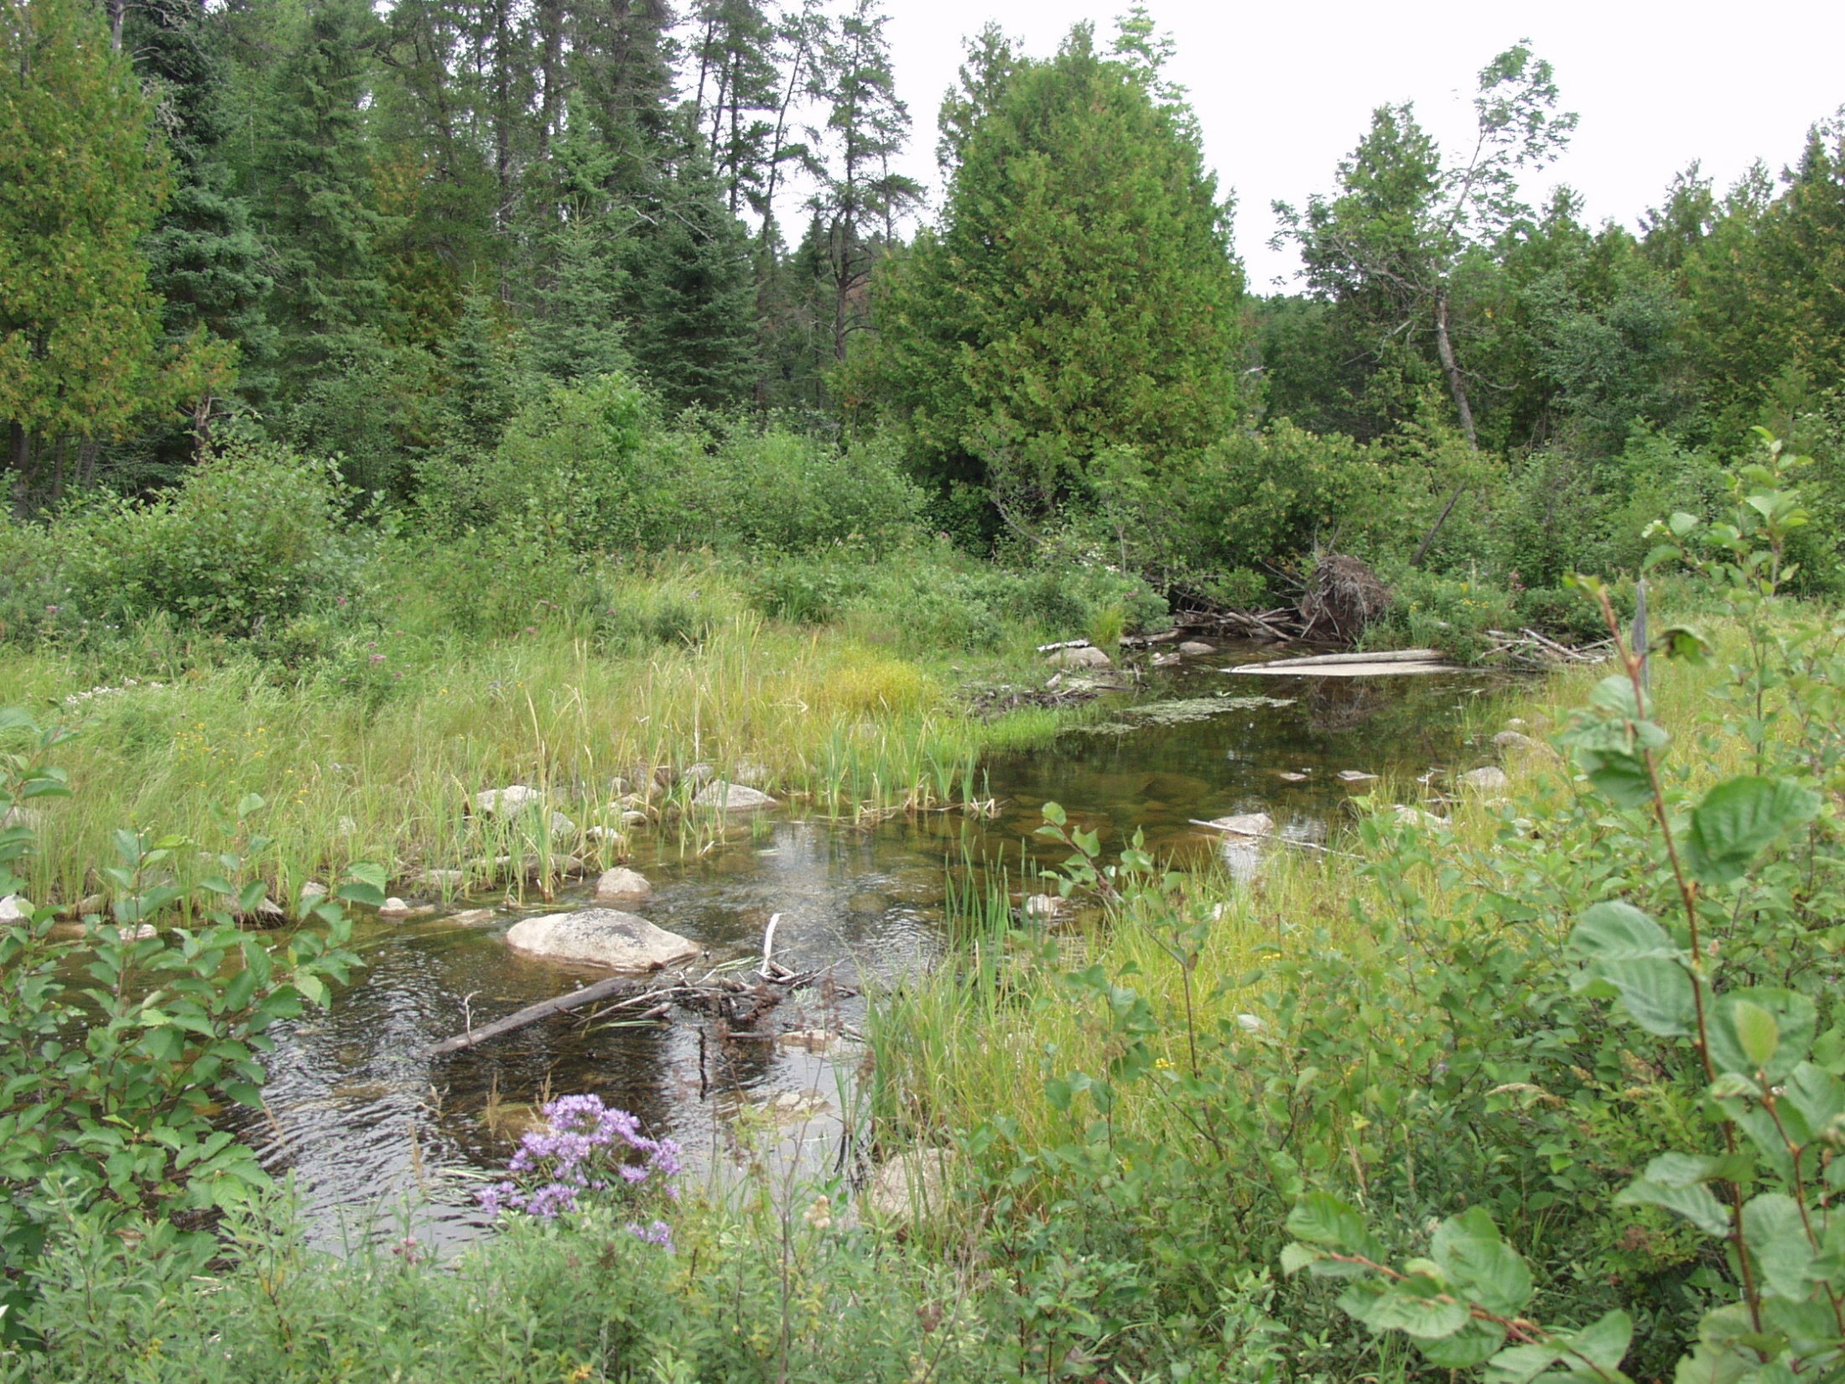
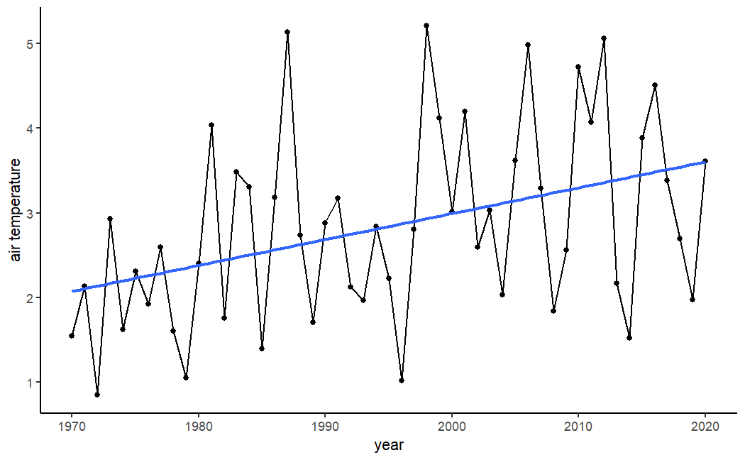
Air Temperature at ELA
Mean annual air temperature rising by 0.49 °C /decade
Global average is ~0.15 - 0.30 °C /decade
Since 2000 eight out of twelve years above long-term mean

Slide 12
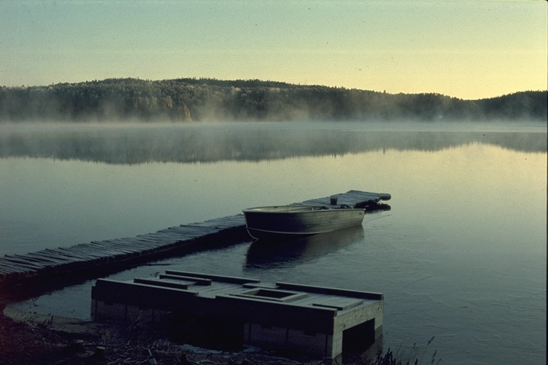
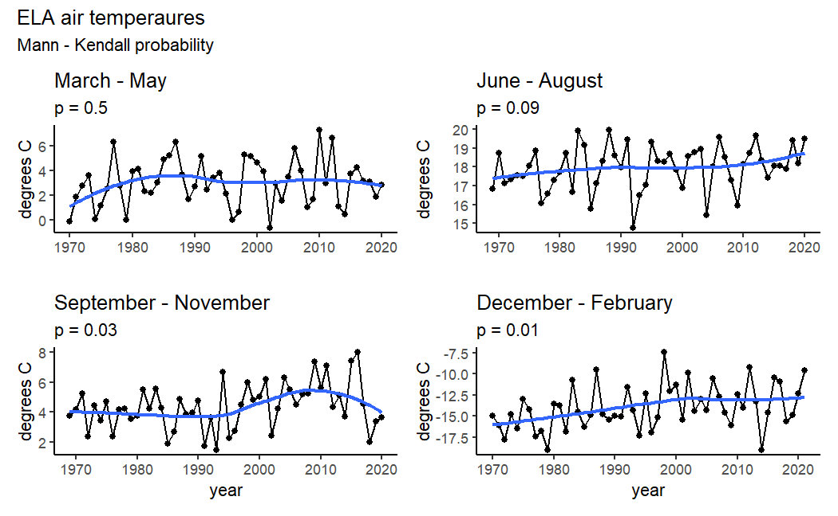
Seasonal Air Temperature at ELA
0.28 °C/decade
Summer temperatures increasing faster or near global annual average

Slide 13
Seasonal Air Temperature at ELA
0.28 °C/decade
Summer temperatures increasing faster or near global annual average
Winter temperatures increasing nearly 3X faster than summer temperatures

Slide 14
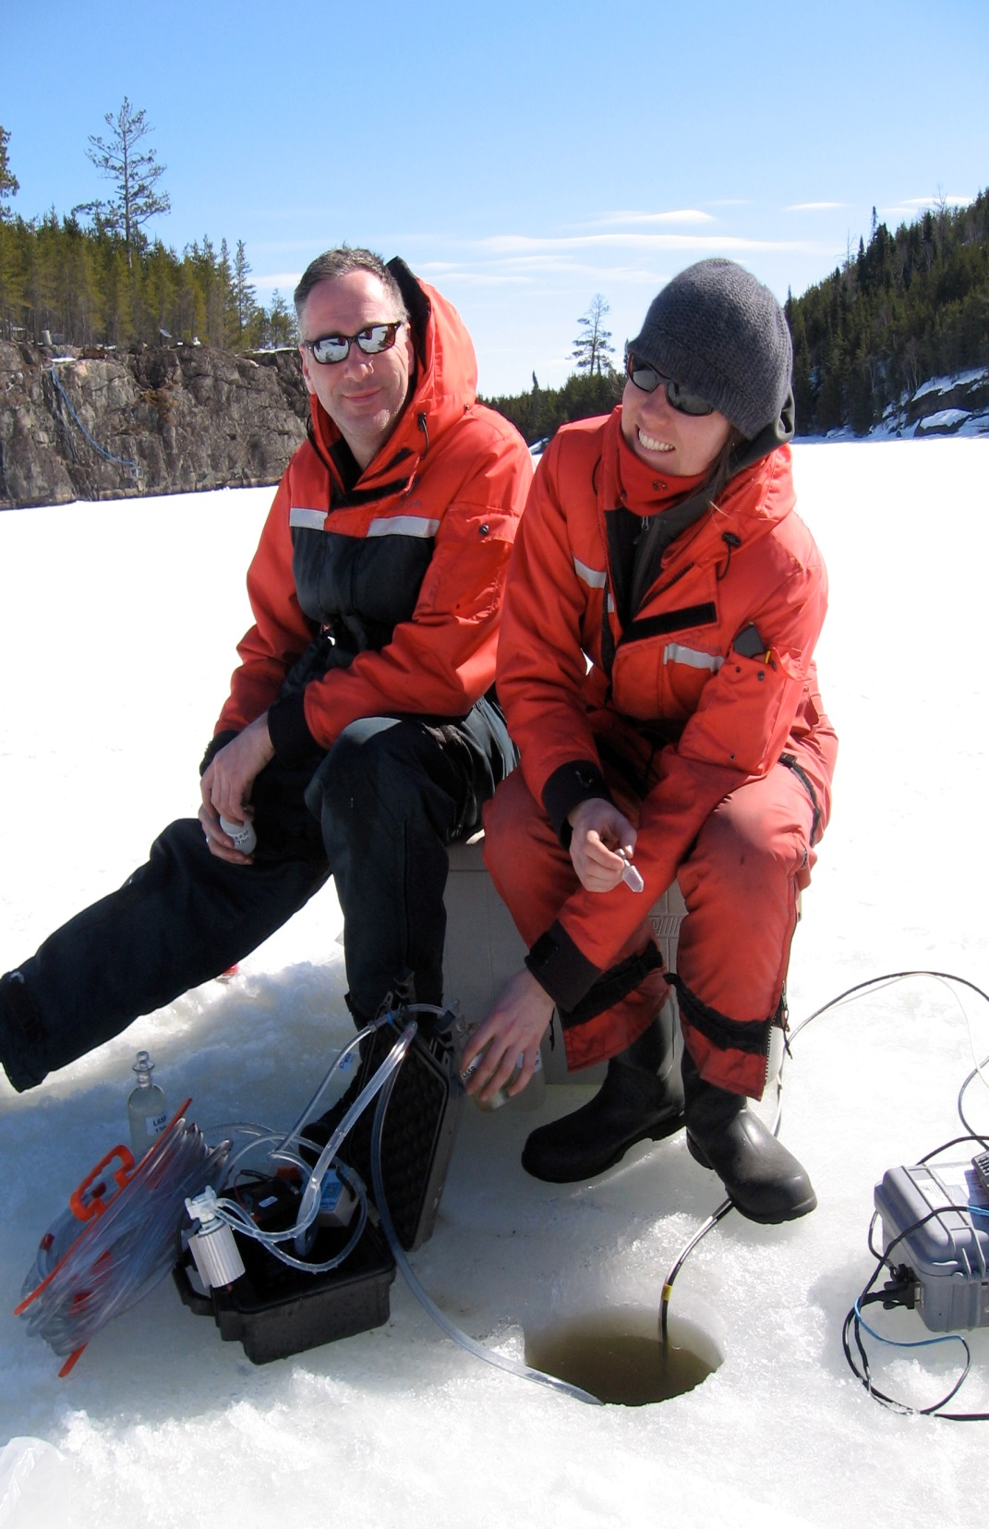
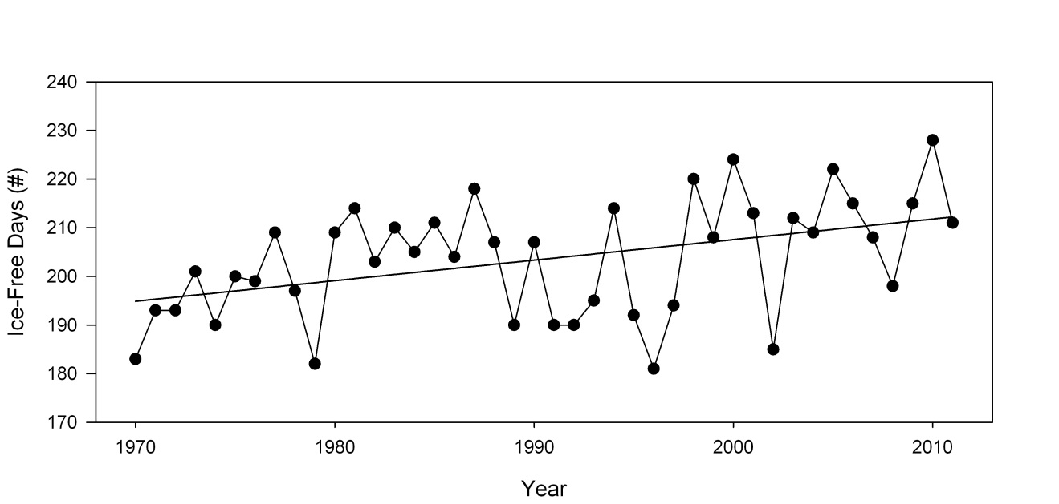
Duration of Ice-Free Season
+4 days/decade
Total change over 46 years is ~20 days

Slide 15
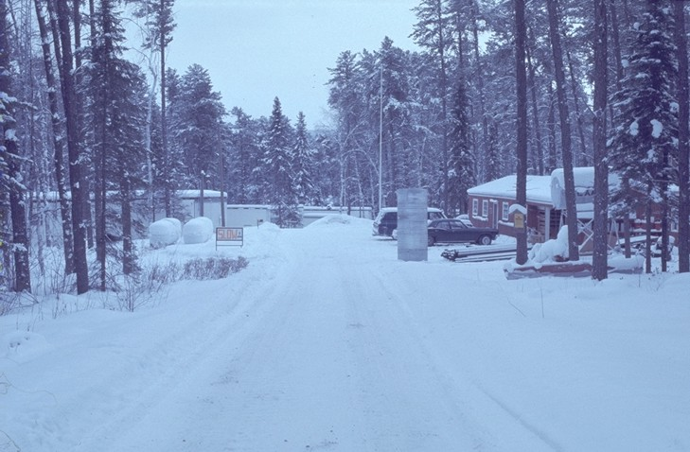
Projected Changes in Ice-cover
Projections based on regional downscaled projections; mean of 20 climate models.
Projected decrease in ice-cover period by 1 month by 2070
Effects influenced by latitude and lake size

Slide 16
What controls surface water temperature?
Heat Loss
18-25 °C
4 °C
Heat
Loss
Energy
Water
Temp
Air
Temp

Slide 17
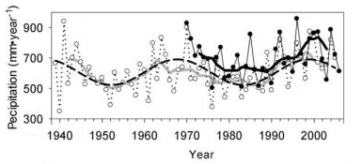
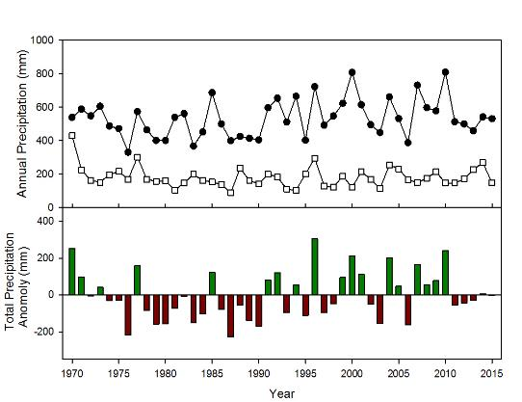
ELA is getting wetter
Modified from Parker et al. 2009
ELA
Kenora
Rainfall increased over much of the study period, but appears to have a ~30 year periodicity
No significant changes in total snowfall
Total precipitation follows a wet – dry – wet pattern
Dry
Wet
Dry
Wet

Slide 18
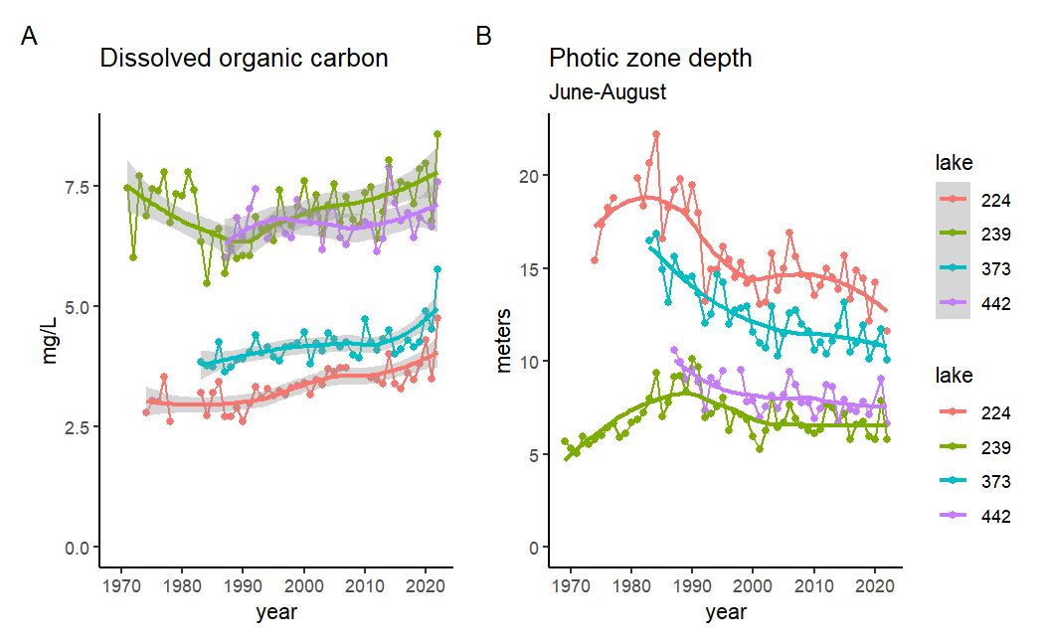
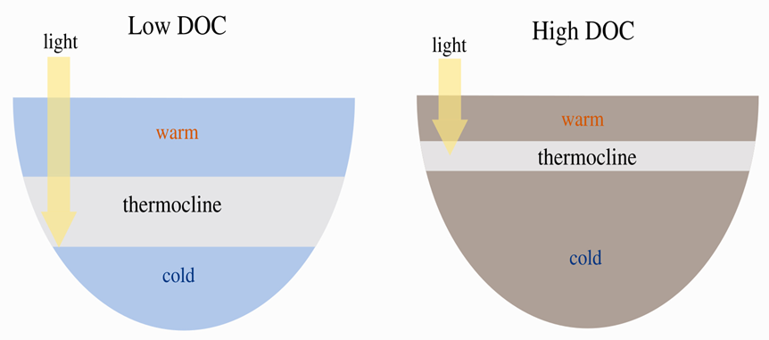
Long-term variation in DOC at ELA
Nutrient concentrations did not consistently change
Notes:
So how has DOC changed in these lakes? DOC concentrations decreased during the driest years in Lake 239 and increased again in recent years. To some degree, similar changes were seen in the other 3 reference lakes, although the records in L373 and 442 start after the dry period. Interestingly, despite differences in the pattern of change for DOC, light attenuation and transparency have changed very similarly among the 4 lakes.. In this plot, you can also see how changes in DOC at lower concentrations generate bigger shifts in transparency than at higher concentrations. As a result, changes in photic depth have been much greater in Lake 224 than in 239, despite greater absolute changes in DOC in the latter lake.

Slide 19
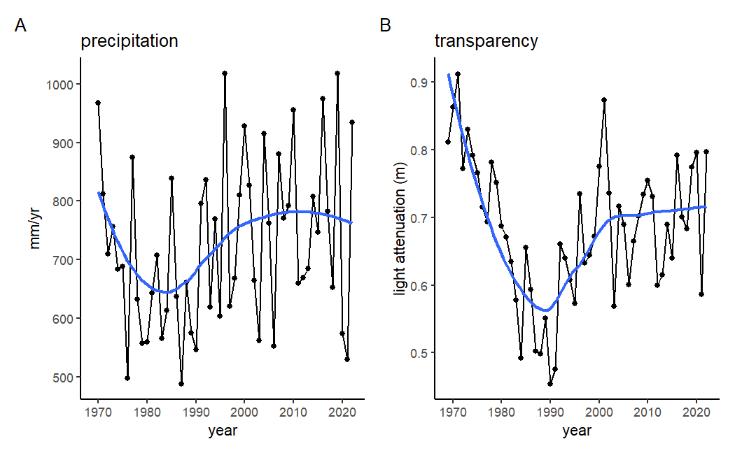
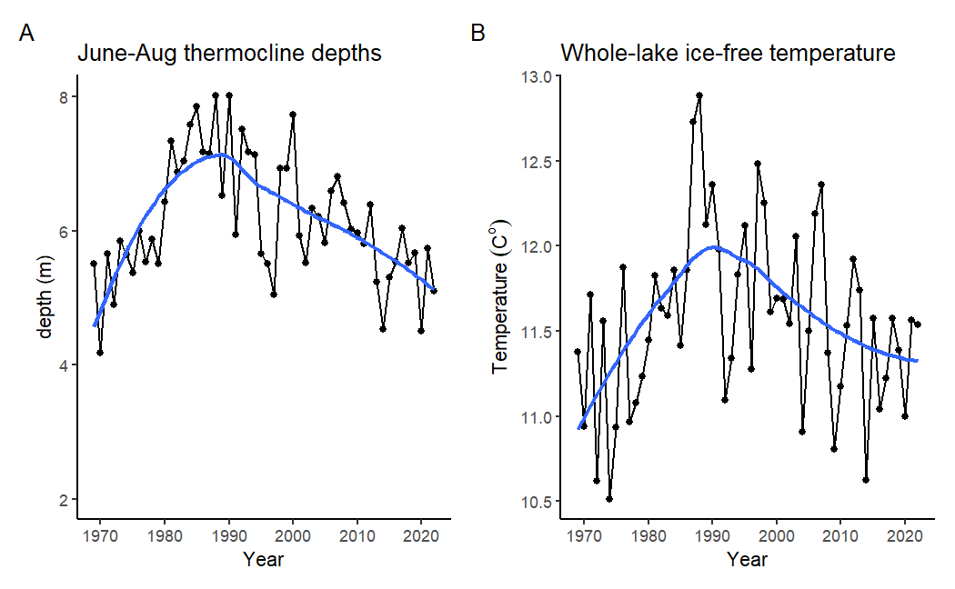
DOC and precipitation
Precipitation increase
Darker Lakes
Shallower thermocline
Cooler lake
Thermocline depth (Z_{Therm})

Slide 20
DOC and precipitation
Precipitation increase
Darker Lakes
Shallower thermocline
Cooler lake
Thermocline depth (Z_{Therm})

Slide 21
DOC and precipitation
Precipitation increase
Darker Lakes
Shallower thermocline
Cooler lake
Thermocline depth (Z_{Therm})

Slide 22
DOC and precipitation
Precipitation increase
Darker Lakes
Shallower thermocline
Cooler lake
Thermocline depth (Z_{Therm})

Slide 23
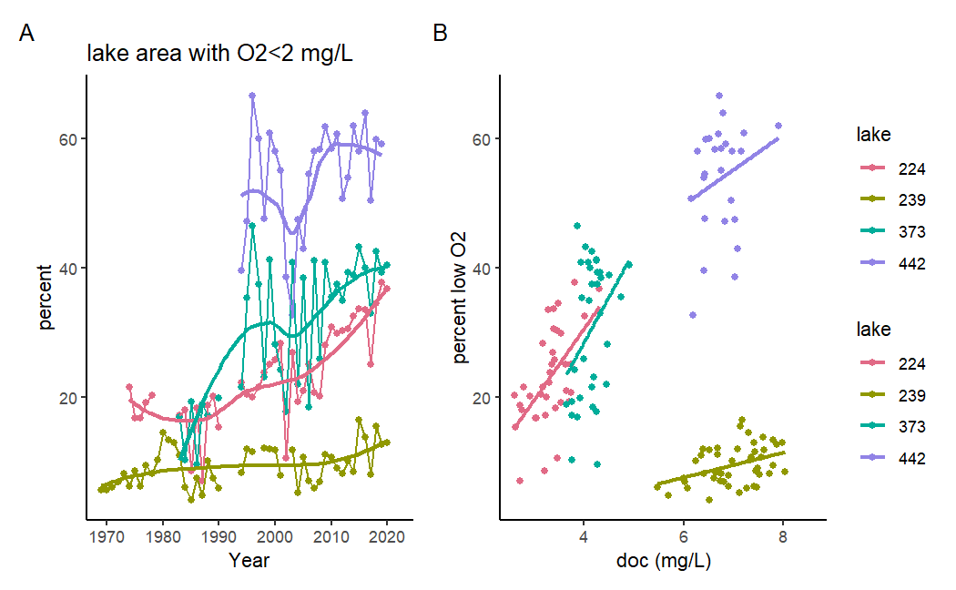
Deep water oxygen
Notes:
Since I know some of you have been discussing a recent paper by Jane et al. on the effects of DOC on deep water oxygen concentrations, I thought I would show these data as well. Overall, there has been a decrease in deep water oxygen concentrations (shown here as an increase in the maximum percent of lake area with oxygen below 2 mg/L) over time. With the exception of L442, these increases have been correlated with changes in DOC.

Slide 24
Cold Water Fish – The ‘Goldilocks’ problem
Longer ice-free period
Shallower thermocline
Habitable zone decrease
O2
Euphotic
Cool
Temperature too high
O₂ too low

Slide 25
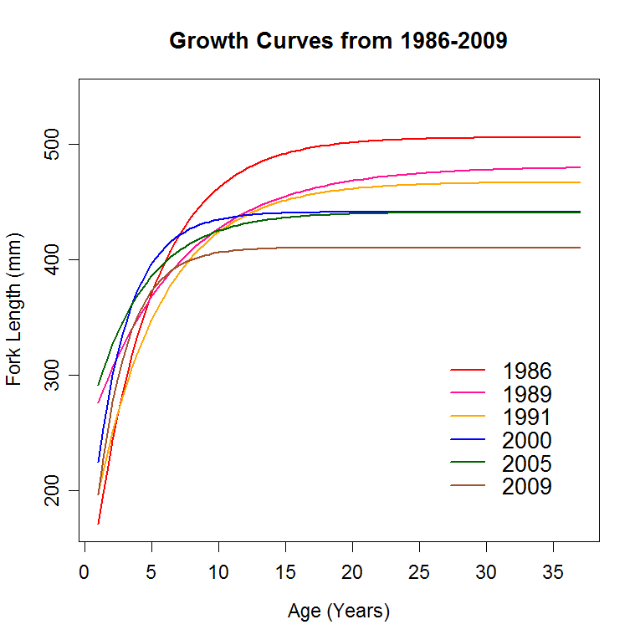
Cold Water Fish – Lake Trout
Reductions in maximum size
Loss of the largest size fish over time

Slide 26
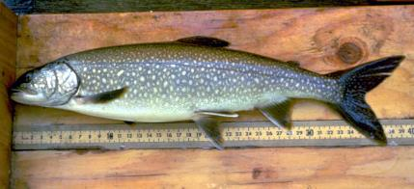
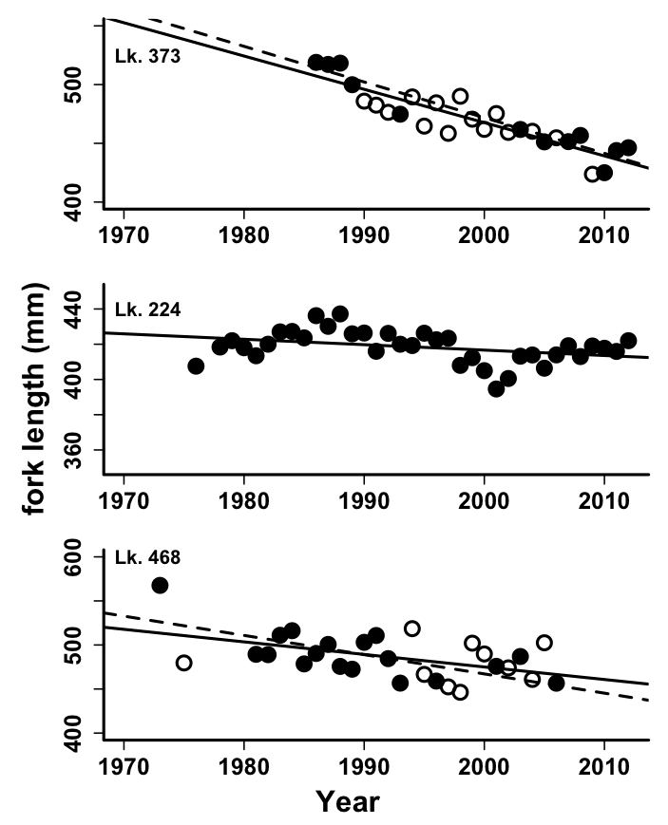
Coldwater fish – Lake Trout
Largest 5% of the population
No significant changes in abundance detected
Reduced adult survival (shift in age class to younger fish)
Shift in length at age (fish getting ‘shorter’)
Shift in fitness (reduced mass per unit length)
M. Rennie, M.Guzzo, P. Blanchfield

Slide 27
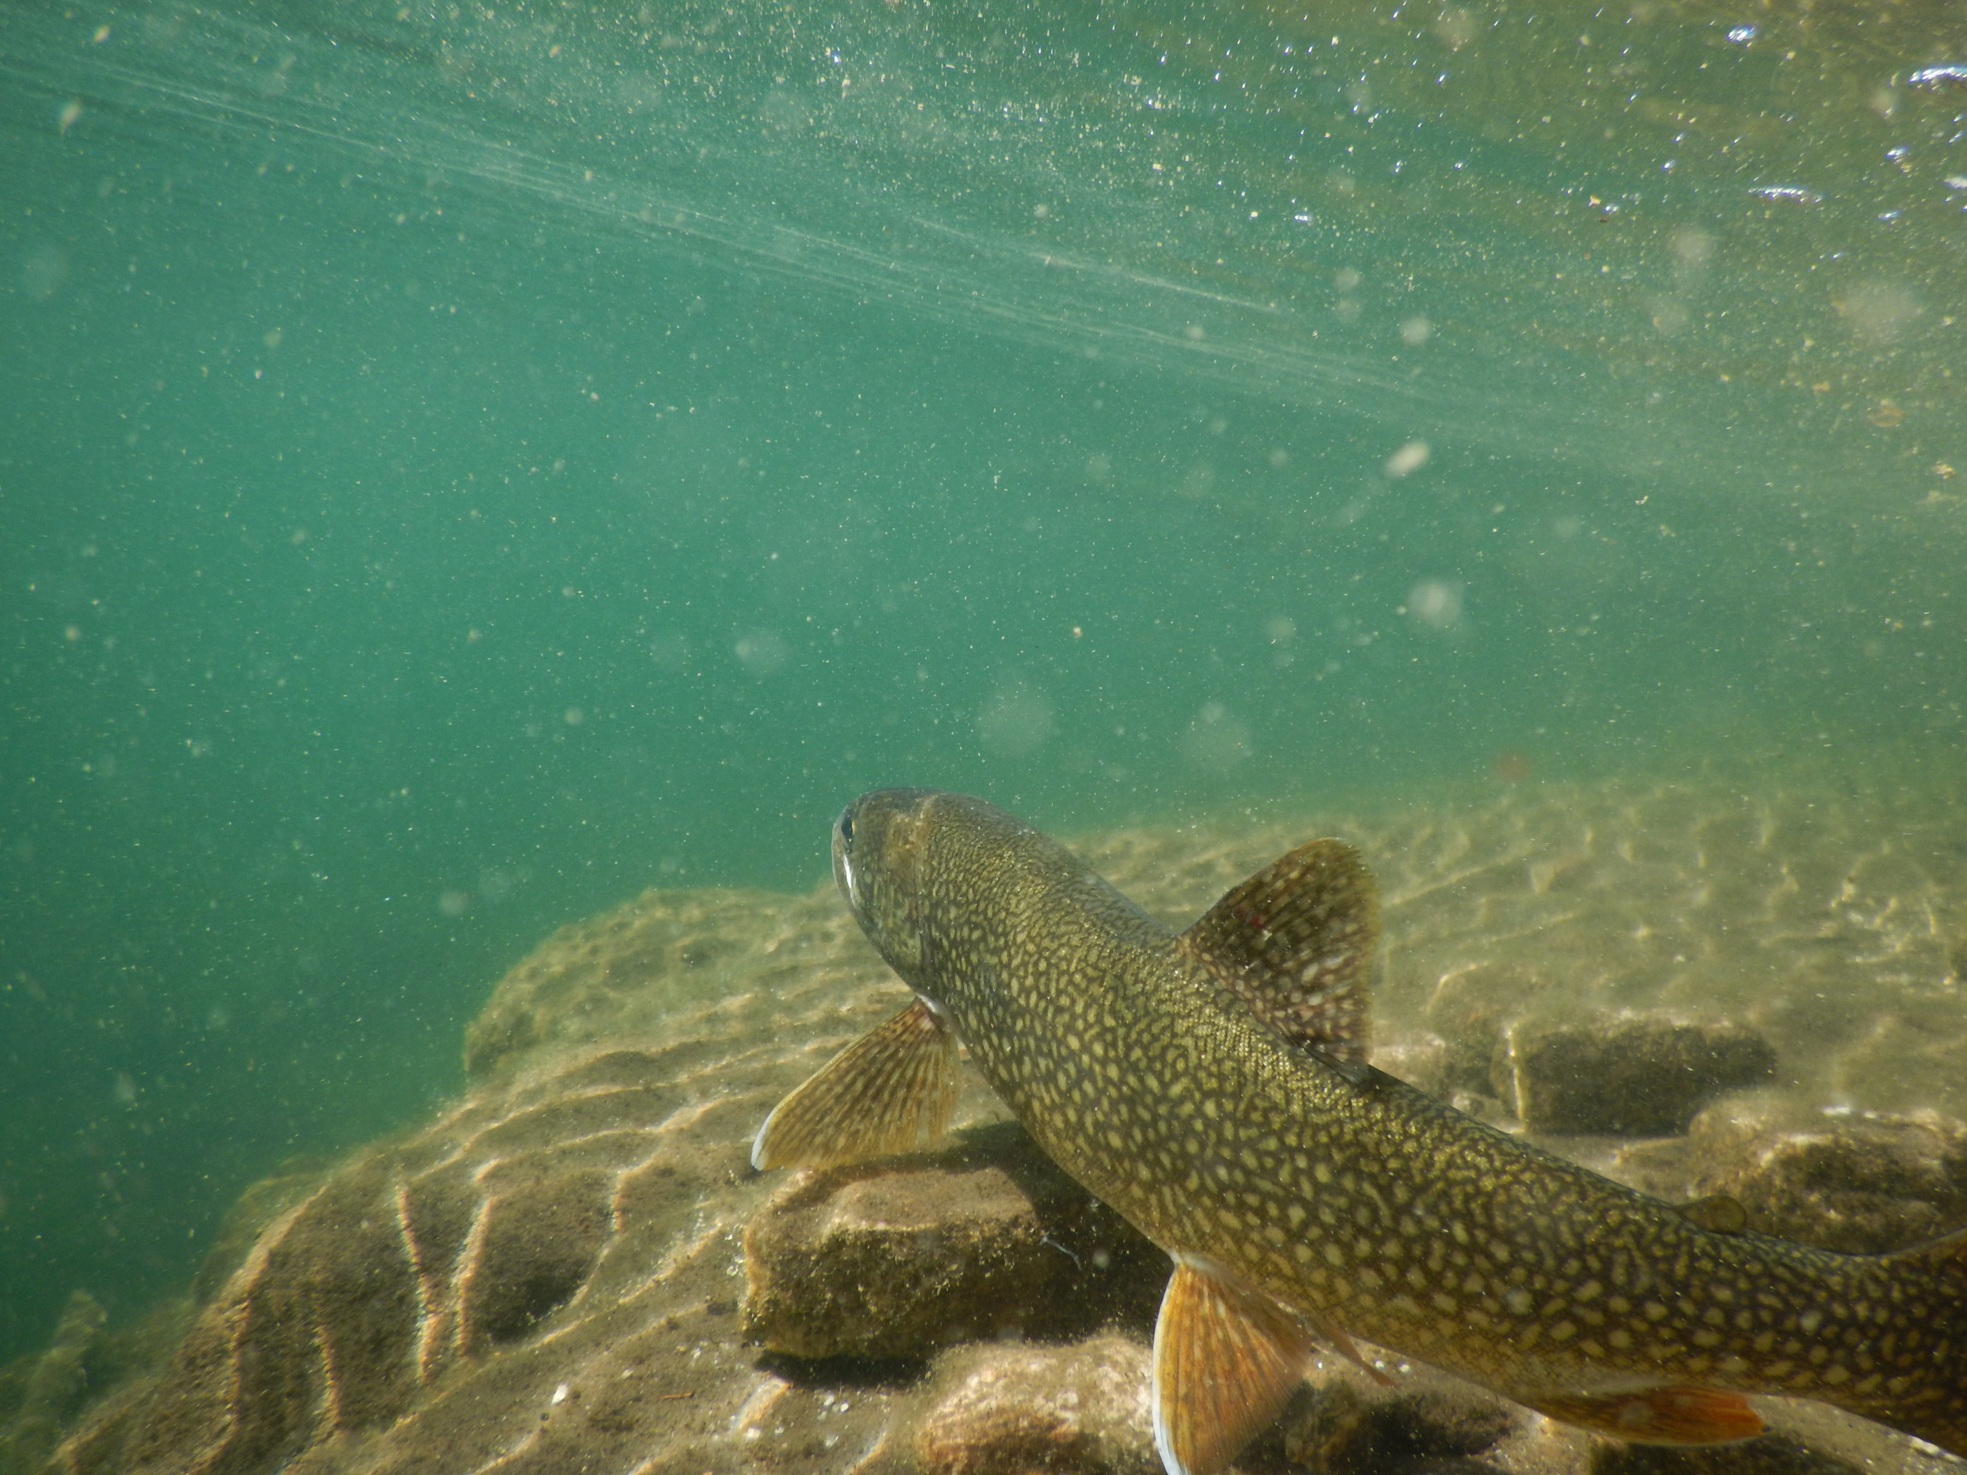
So, what now?

Slide 28
Responding to New Challenges
Invasive species : Broad scale monitoring
Interpreting historical data : Data improvements
Technological changes : In-situ monitoring program, lab improvements
Earlier or later field seasons : Forecasting

Slide 29
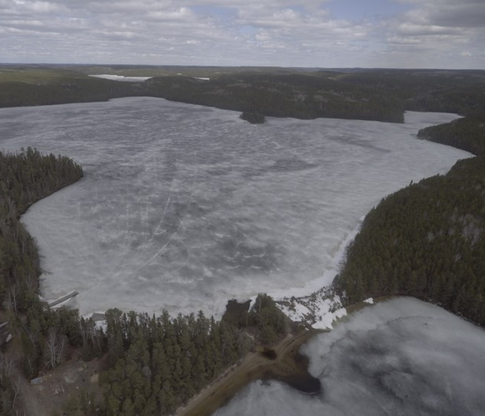
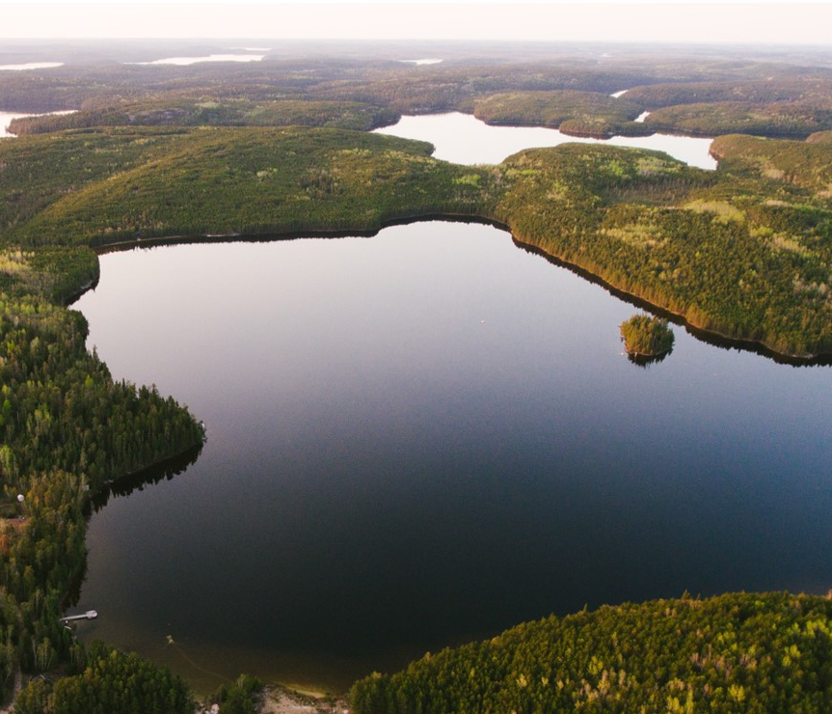

What are the drivers of ice-off?
Prior research:
Notes:
Duration of ice cover is dropping at about 4 days / decade
Some of the big drivers are lake size, snow thickness, ice thickness, and air temperature
Exact causal relationships difficult to model mechanistically
Main takeaways!
Duration of ice cover is dropping at about 4 days / decade – predicting ice-off matters for many remote communities with ice roads
Machine learning is a powerful tool for making sense of large amounts of data with “high dimensionality”
Predictive modeling lies at the end of a LOT of “unsung” work

Slide 30
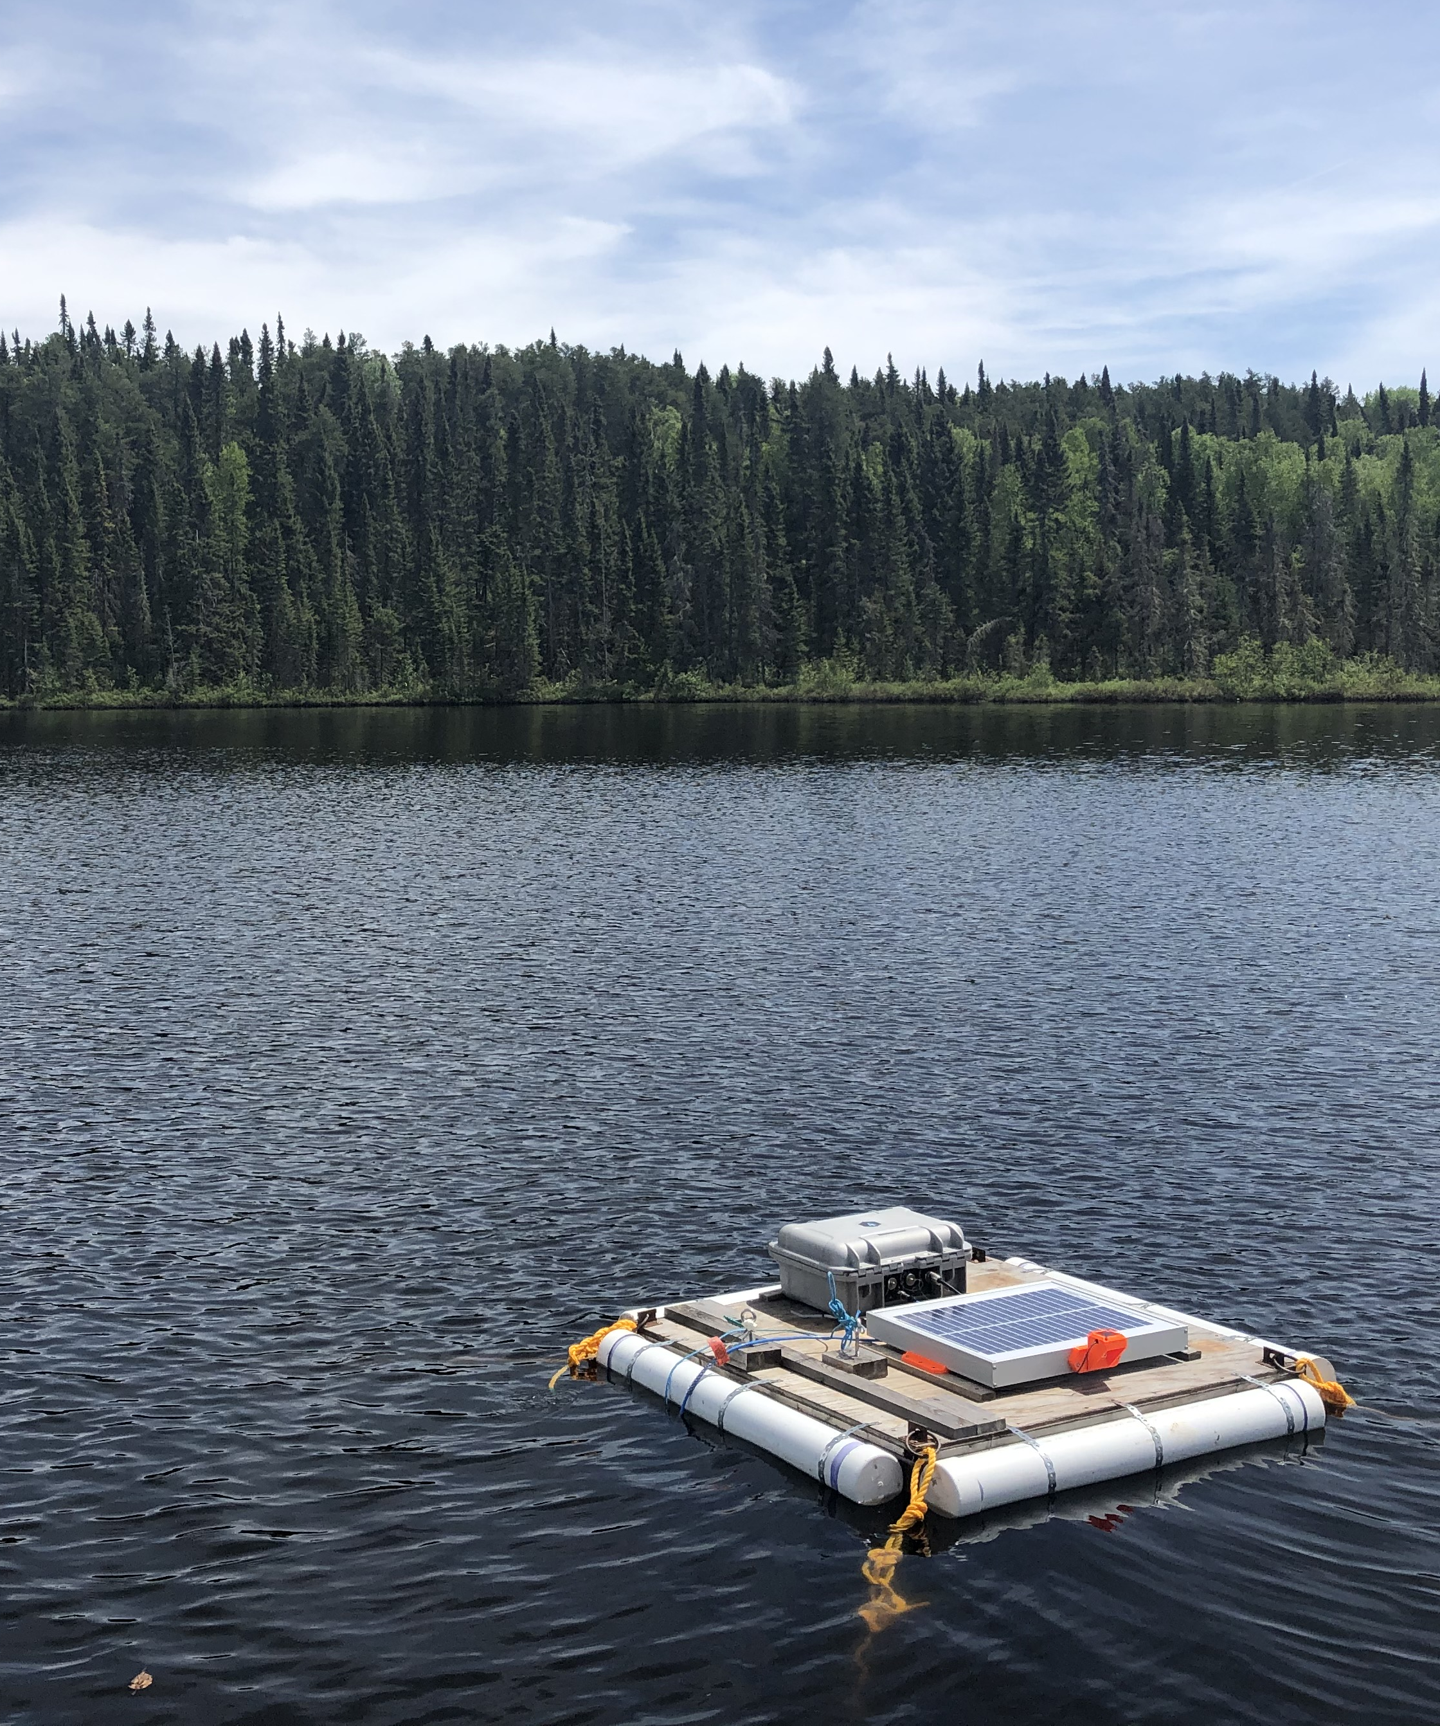
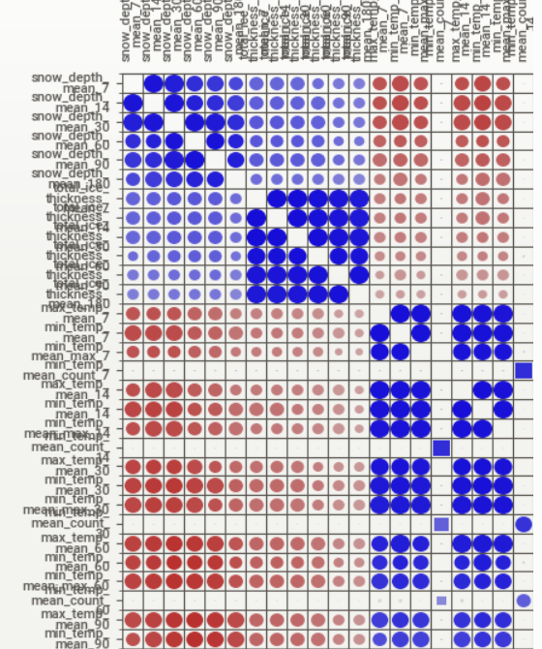
Data & Tech at IISD-ELA
Figures (from left):
A real-time monitoring station on lake 227
A flowchart depicting the data infrastructure on AWS
A diagram of Pearson’s correlation coefficients for ice-off parameters
Notes:
3 Areas of data & tech
Data collection:
Aquatic Life & other tech partnerships
In-situ monitoring program (Aidan, Sonya, Scott…)
Data handling
Cloud migration & security
Chris database updates & pipelines
Computation
Lots of existing capacity for data analysis, but have yet to systematize and scale across the organization
Only just starting to leverage machine learning

Slide 31
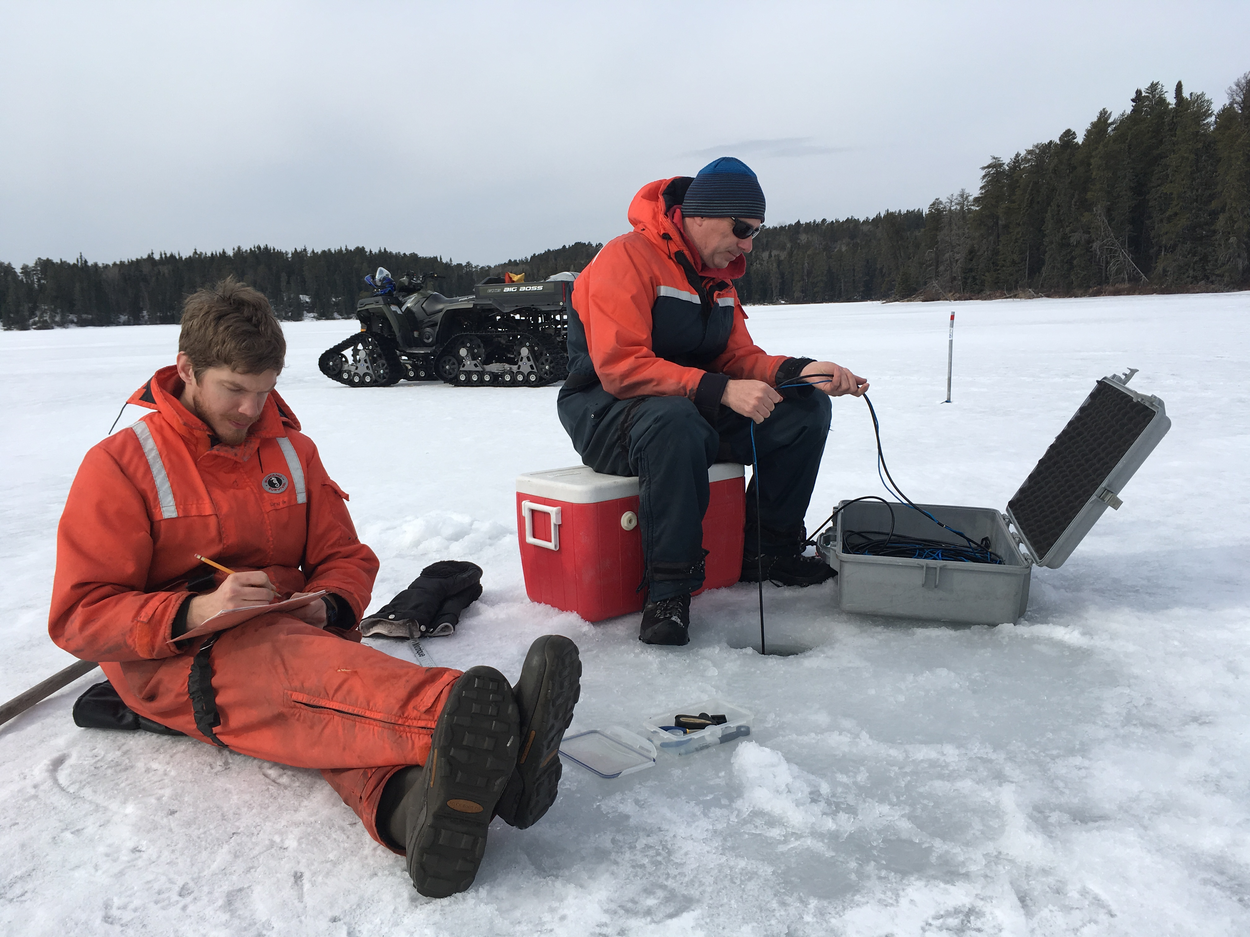
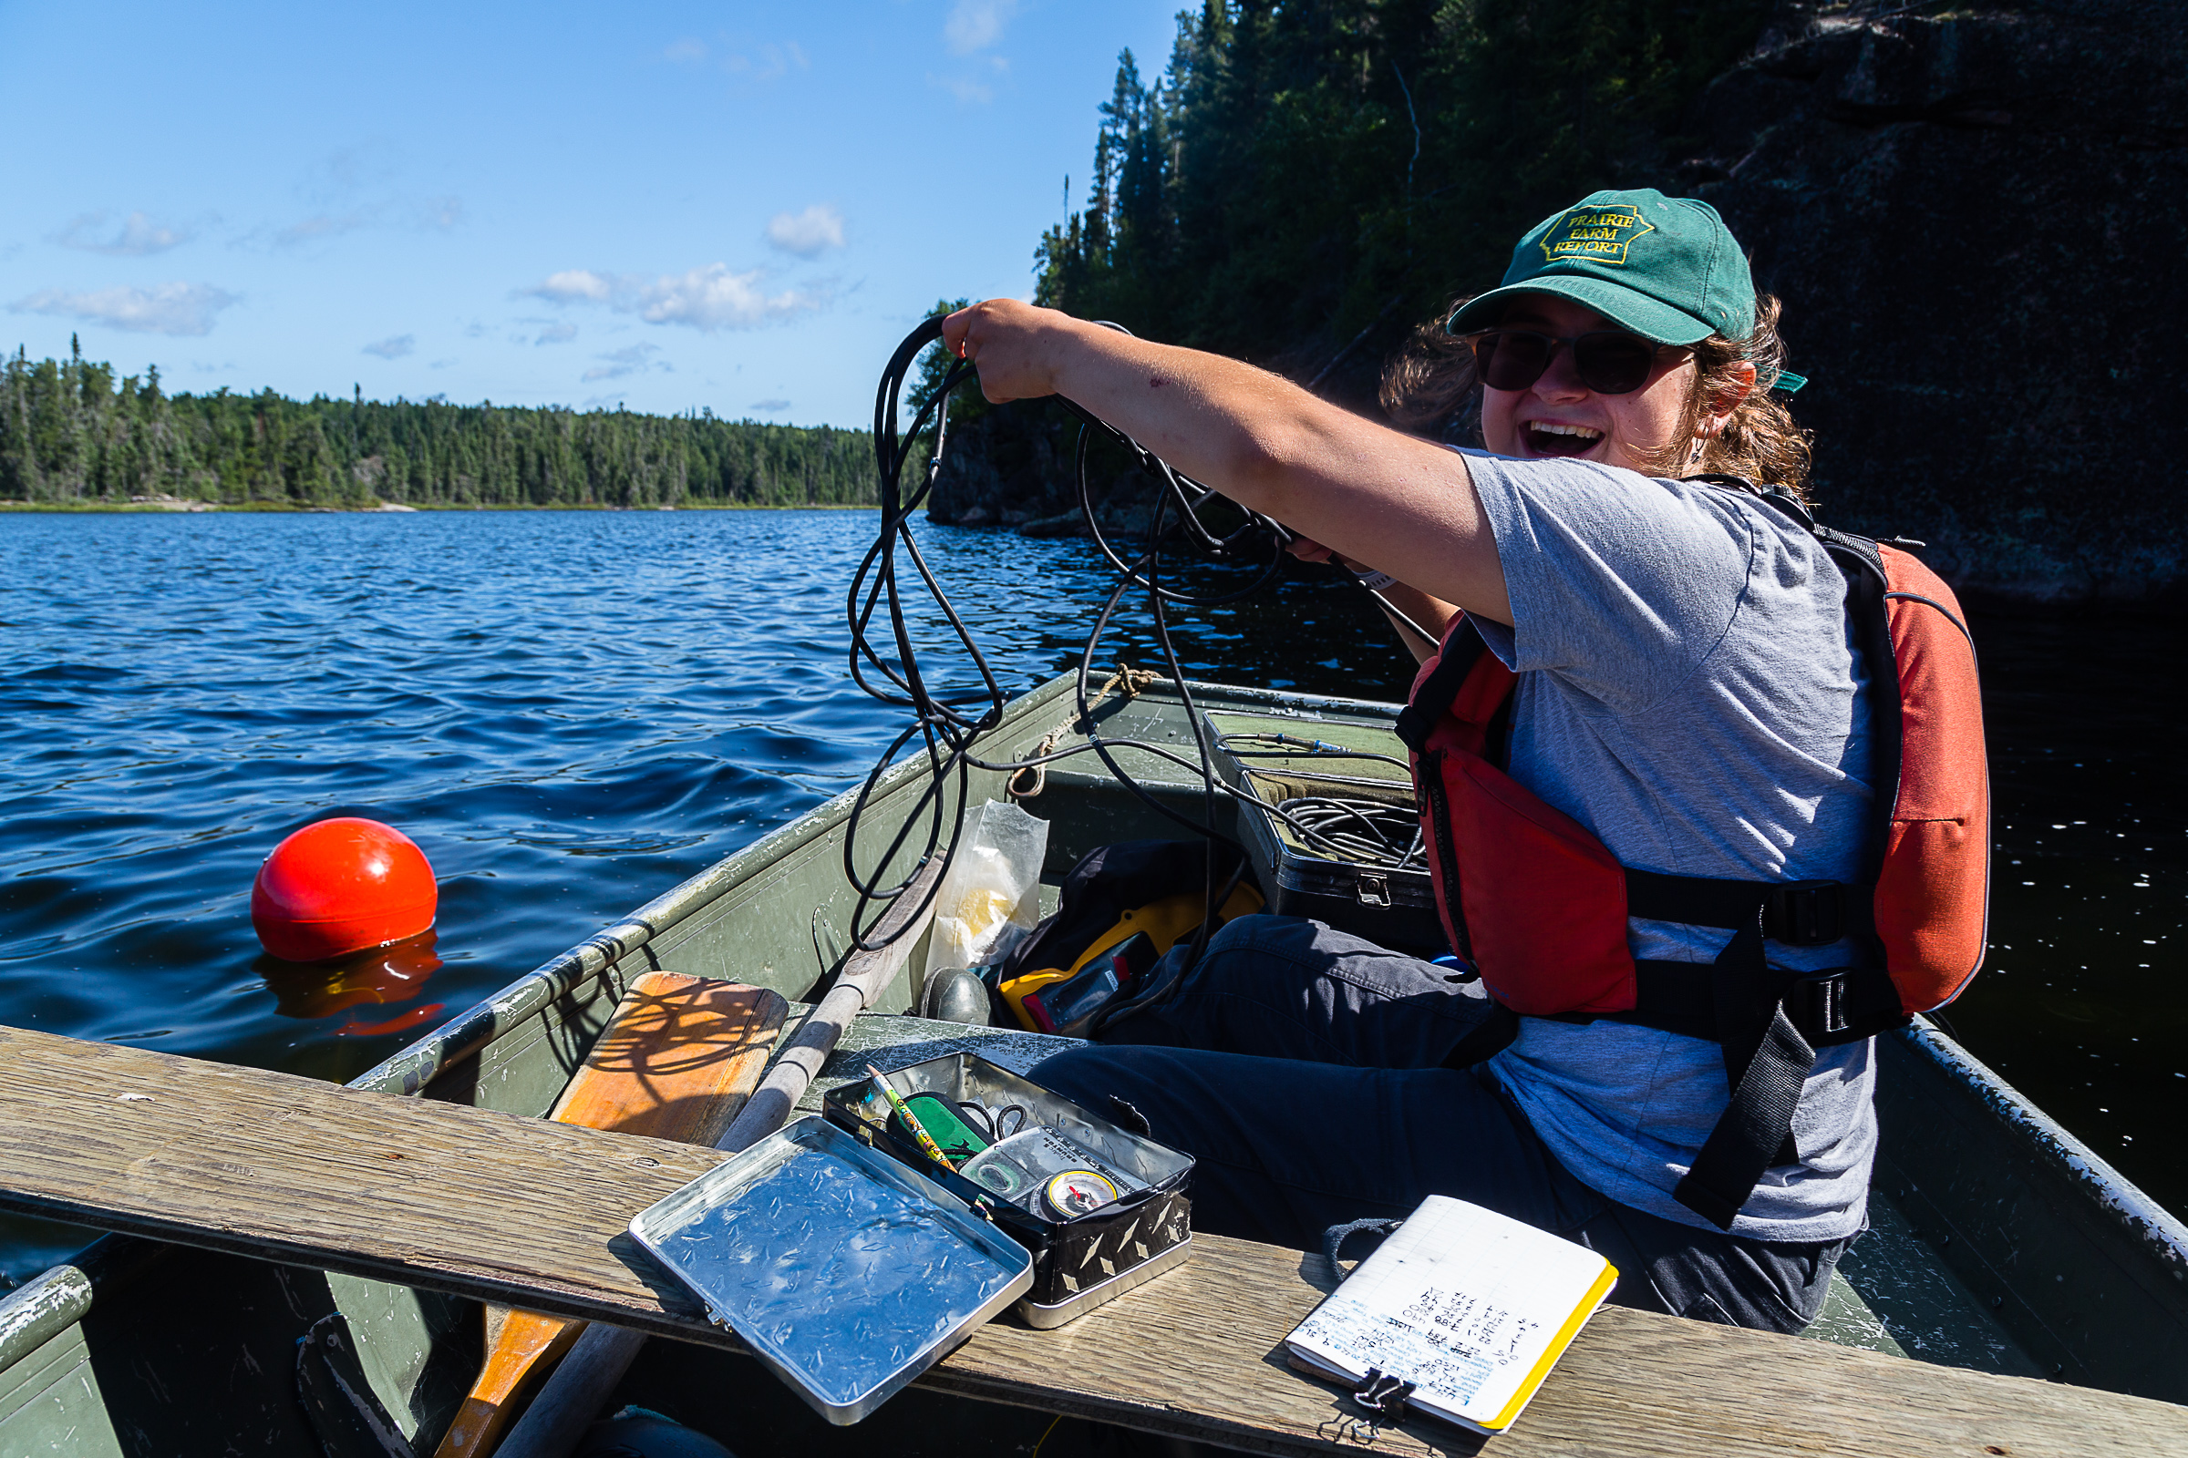
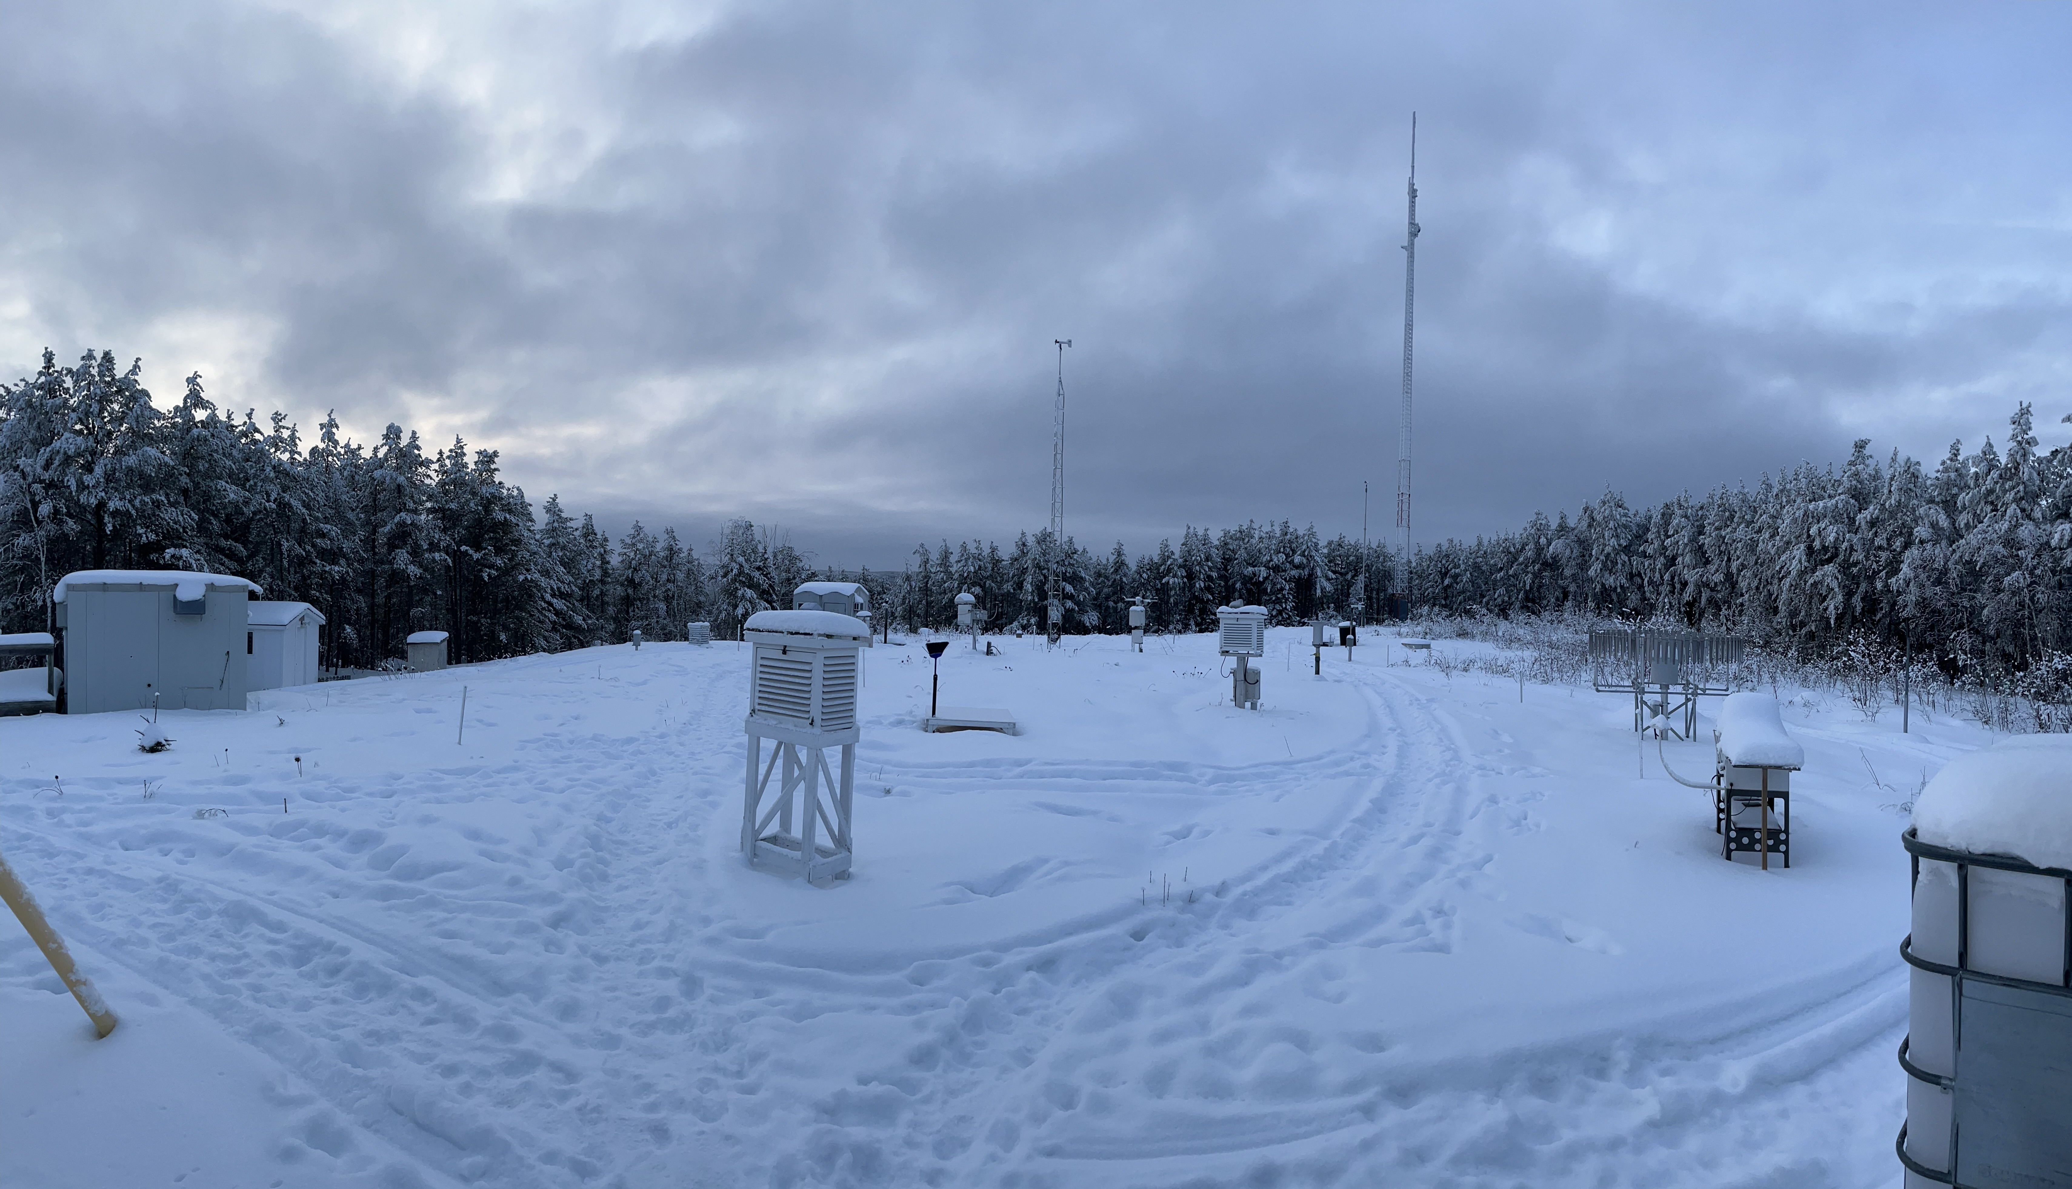
Meteorology & Limnology Data
Notes:
Ken, Paul, and Zoe

Slide 32
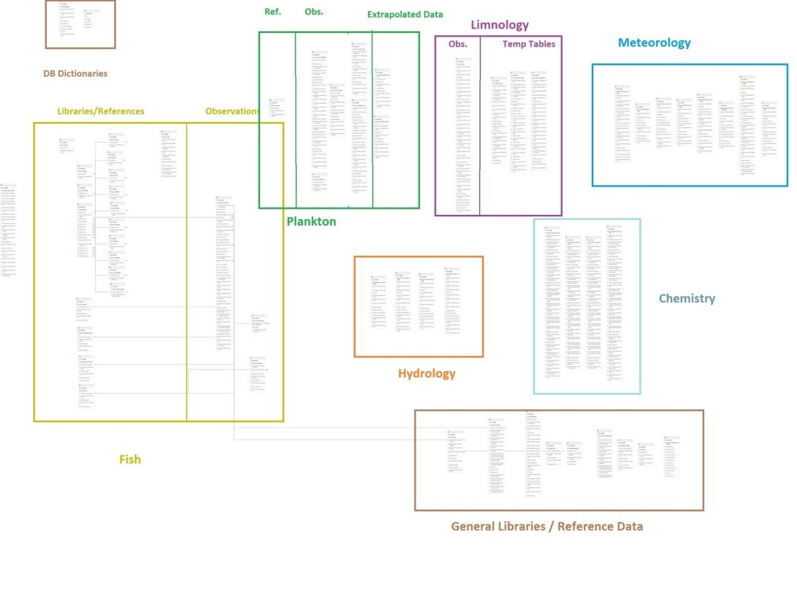
Improvements to the Database
Below: a diagram (ERD) depicting data tables and fields in the ELA master database
ELA data in 2023 vs. 2013
digitized
relational master database
manual qa/qc pipelines
cloud storage
secure access management
In the works…
automated qa/qc & upload
machine learning pipeline
networked instrumentation

Slide 33
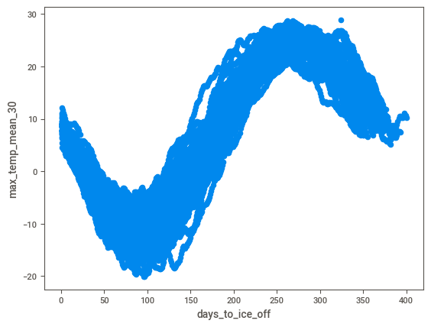
Data pre-processing
Feature creation
Dependent variable: Days until ice-off
Forecasting model – need for relationships across time
Summary values (mean, max, min) were calculated for specified time intervals (same day, last 7 days, 14 days… 180 days)
Feature selection
Mutual information checks
Dimensionality reduction
Notes:
Cut EDA?

Slide 34

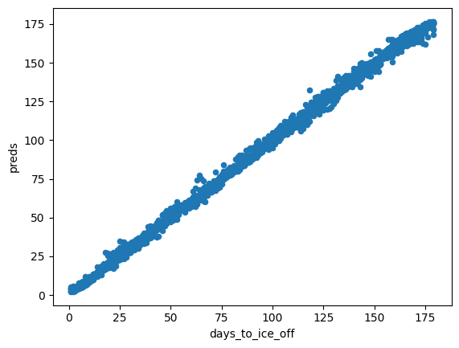
Model development
Optimization
Regularization / pruning (reduce overfitting)
Hyperparameter tuning (cross-validation)
Recursive feature elimination
Model Testing
Time-based split of training & test sets
Random Forest - mean prediction error -0.6 days
- standard deviation ~ 1.5 days
Notes:
OVERFITTING!
- High risk, esp. when parameters are highly correlated and when ratio of parameters to records is high.

Slide 35
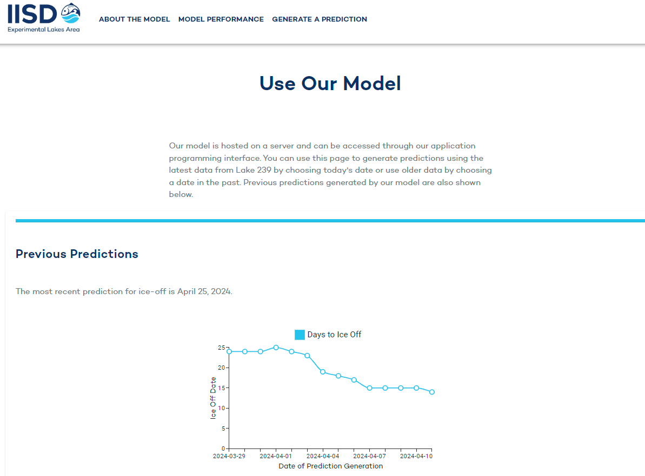
Deployment
User Interface
A user interface (React App) was developed allowing users to run the model and view present and past predictions.
2024 model predictions
Prediction on March 7th: April 30
Prediction on April 10th: April 25
Actual ice-off date… May 6
Results

Slide 36
Why and how to plan for climate change
Slow and steady wins the race
We benefit from the gifts of previous generations
Adapting to changes and innovations takes patience and dedication
Many Canadians and Indigenous peoples value their lakes!

Slide 37
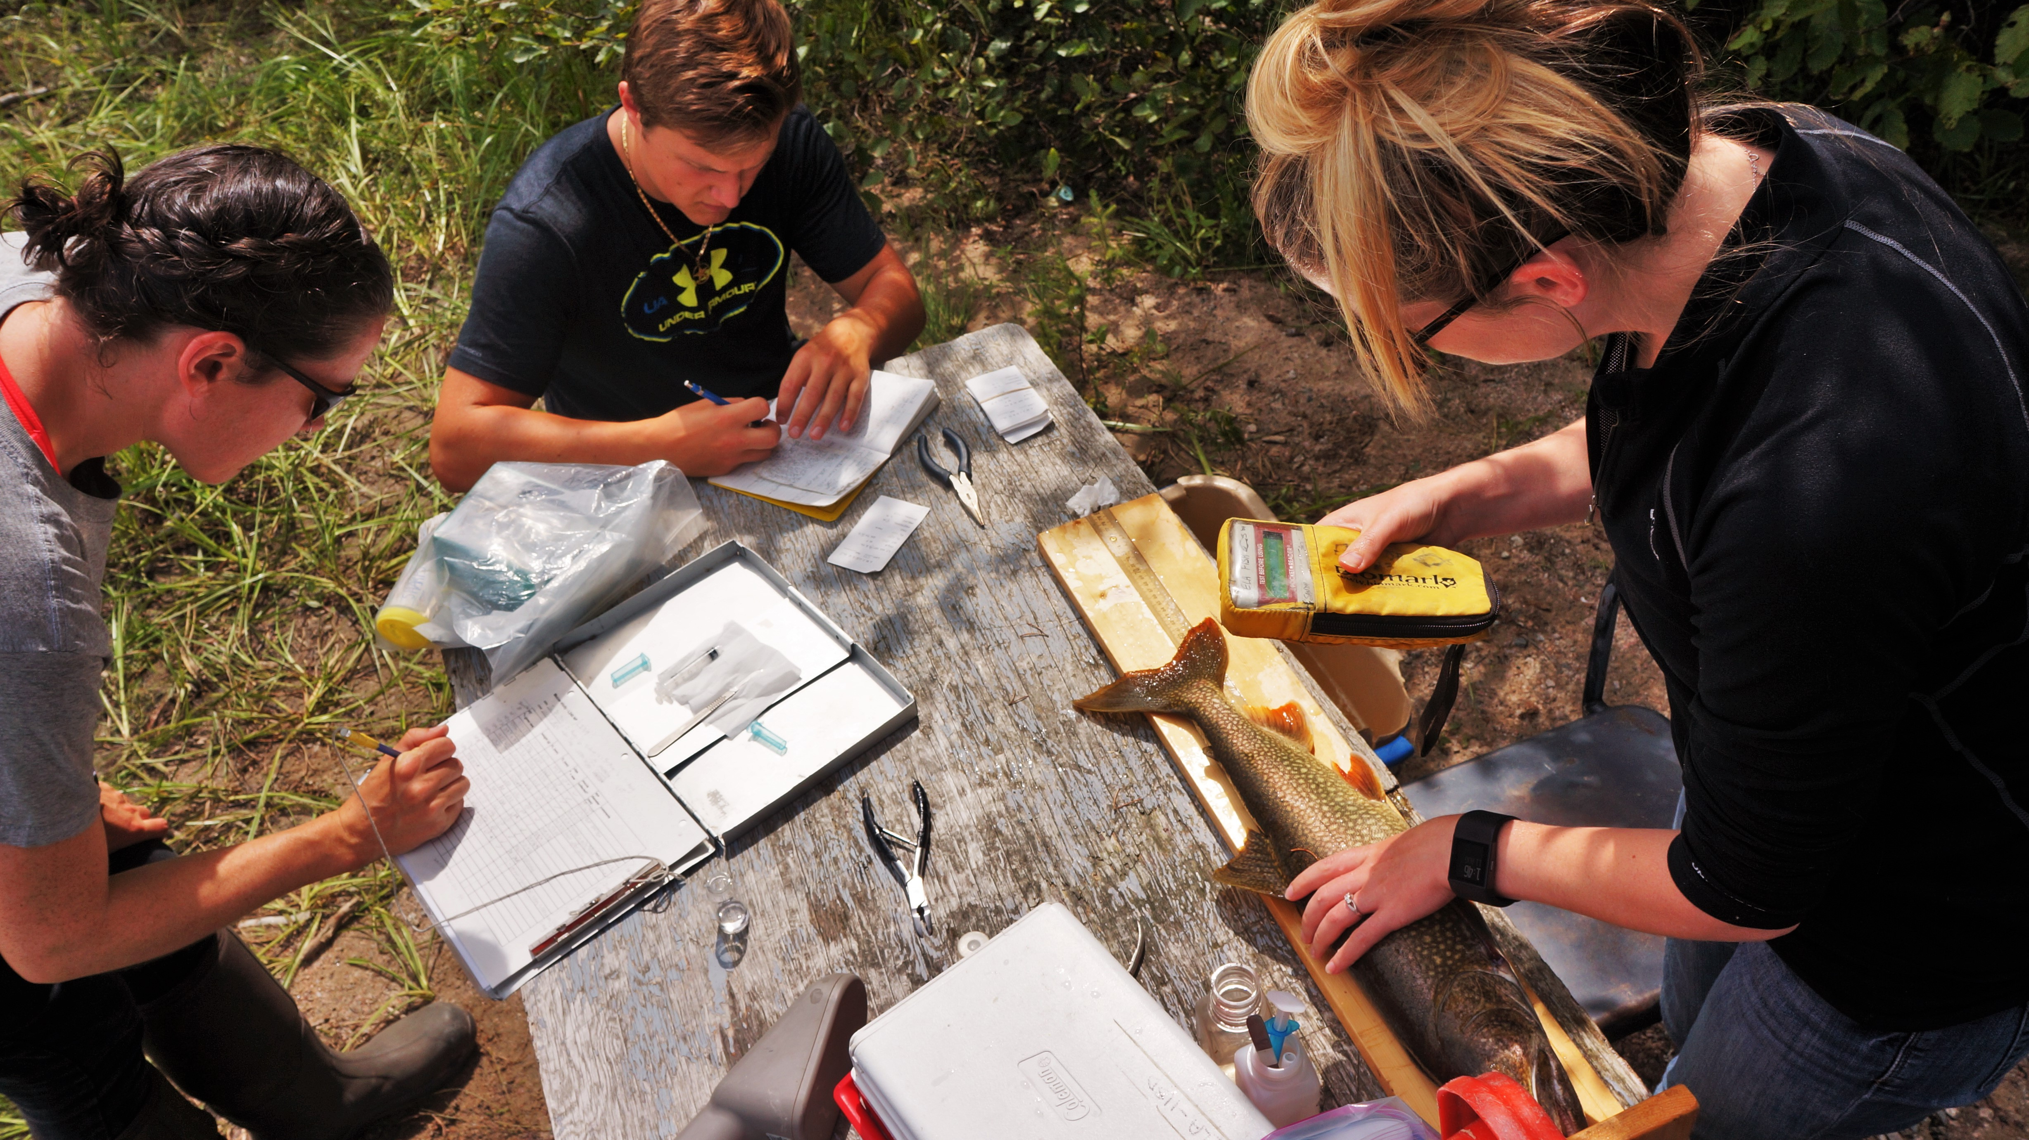
THANK YOU
FOLLOW US!
www.iisd.org/ela
TWITTER @IISD_ELA
INSTAGRAM @IISD_ELA
FACEBOOK @ExperimentalLakes
Sign up for our quarterly newsletter http://bit.ly/elanews

